Slide 1
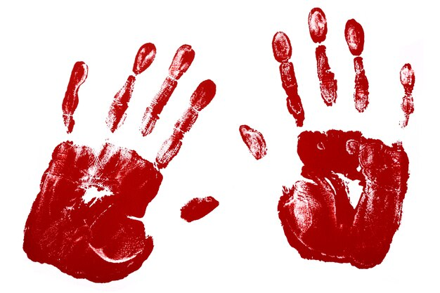
SOCIOLOGY OF IDENTITY
GNED 500
WEEK 3
Hand palm by kstudio - freepik.com
Notes:
SOCIAL IDENTITY 1

Slide 2
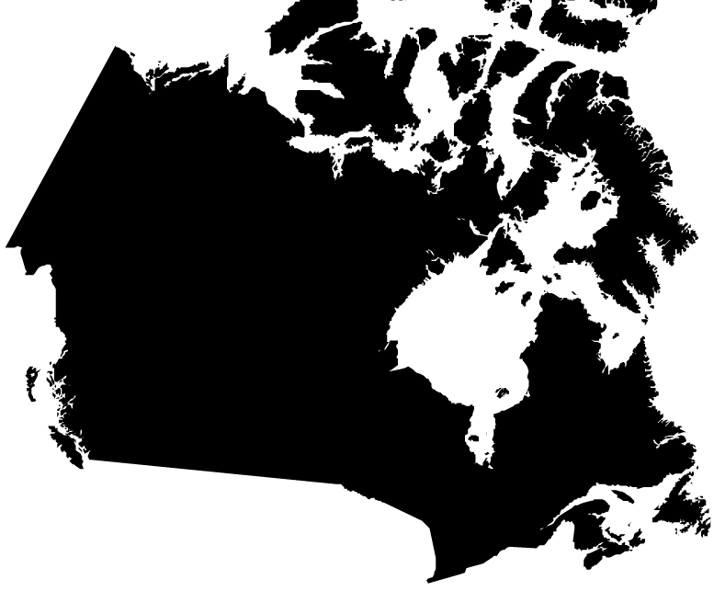
Acknowledgement
Traditional Lands
Canada Map Vectors by Vecteezy
Notes:
Acknowledgement of Traditional Lands
Centennial is proud to be a part of a rich history of education in this province and in this city.
We acknowledge that we are on the treaty lands and territory of the Mississauga’s of the Credit First Nation and pay tribute to their legacy and the legacy of all First Peoples of Canada, as we strengthen ties with the communities we serve and build the future through learning and through our graduates.
Today the traditional meeting place of Toronto is still home to many Indigenous People from across Turtle Island and we are grateful to have the opportunity to work in the communities that have grown in the treaty lands of the Mississauga’s.
We acknowledge that we are all treaty people and accept our responsibility to honor all our relations

Slide 3

AGENDA
UPDATE
REVIEW LAST CLASS
LEARNING OUTCOMES
WHO AM I?
SOCIAL CONSTRUCT OF IDENTITY
ESSENTIALISM
SOCIAL CONSTRUCTIONISM
SOCIAL STATUS
ACHIEVED STATUS & ASCRIBED STATUS
ROLES
FRONT AND BACK STAGE BEHAVOIUR
SOCIALIZATION
LOOKING GLASS SELF
SOCIAL CONSTRUCT OF GENDER
GENDER
SEXUALITY
GENDER PERFORMATIVITY & GENDER SOCIALIZATION
GENDER STEREOTYPES & GENDER ROLES
GENDER & POWER
GENDER & FASHION
INTERSECTIONALITY
STEREOTYPES
STEREOTYPE THREAT
PREJUDICE AND DISCRIMINATION
DISCRIMINATION
SOCIAL CONSTRUCTION OF RACE
RACE AND RESISTANCE
INDIGENOUS IDENTITY
Photo By Freepik.com
Notes:
UPDATE
REVIEW LAST CLASS
BELIEF
CONFIRAMTION BIAS
IDEOLOGY
ASSUMPTIONS
SOCIAL CONSTRUCT OF IDEOLOGY
DOMINANT IDEOLOGY
DOMINANT DISCOURSE
HEGEMONIC DISCOURSE
COUNTER IDEOLOGIES
MOVEMENTS

Slide 4

LEARNING OUTCOMES
At the end of this session, you will be able to:
Apply sociological concepts to understand identity.
Identify the elements that make up an identity.
Examine how identity is socially constructed.
Determine how identity is the product of social structures and culture.
Discuss how identities are intersectional.
Examine the difference between gender & sex
Evaluate the impact of discrimination, prejudice and stereotypes.
Identify with the identity of Canadian Aboriginal Peoples as they see themselves.
LEARNING
OUTCOMES
Vector by pch.vector - freepik.com
Notes:
At its most basic level, Global Citizenship is the idea that we belong to a shared community of human beings.
This means that we think of ourselves not strictly as citizens of a particular nation, but as citizens of the whole world.
To understand the concept of global citizenship we need to begin with its foundations
First we need to consider: what is a citizen?

Slide 5
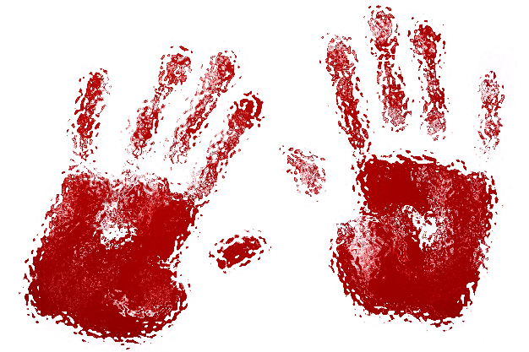

WHO AM I?
Who am I?
List 5 aspects of your identity:
I am _____
I am a _____
Identity is a complex issue.
Each of us will identify ourselves differently as each is unique
Hand palm created by kstudio - freepik.com
Notes:
Who am I?
List 5 aspects of your identity:
I am _____
I am a _____
Identity is a complex issue.
Each of us will identify ourselves differently and each of us are unique
“Perhaps instead of thinking about identity as an already accomplished fact […] we should think, instead, of identity as a ‘production’ which is never complete, always in process and always constituted within, not outside, representation” – Stuart Hall

Slide 6
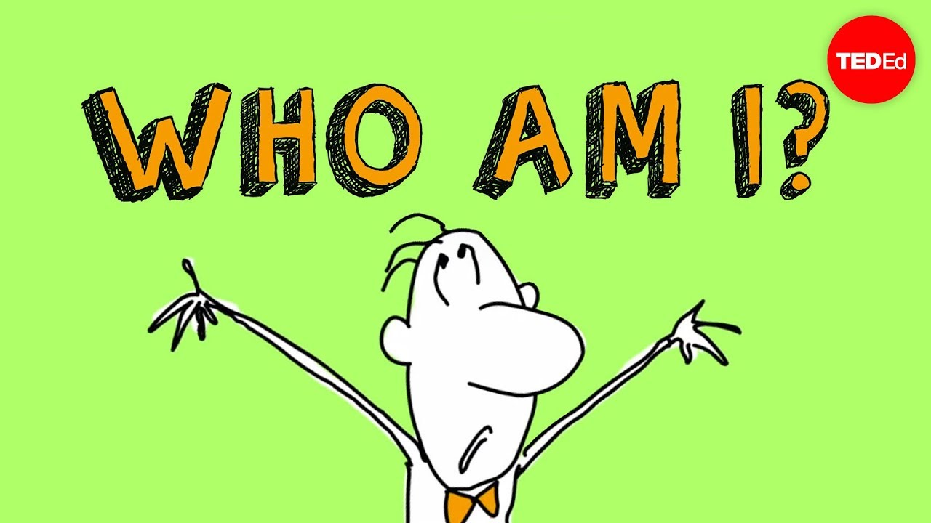
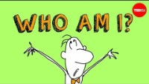
Notes:
https://youtu.be/UHwVyplU3Pg
Who am I?
Ted Talk -A philosophical inquiry - Amy Adkins
Throughout the history of mankind, the subject of identity has sent poets to the blank page, philosophers to the agora and seekers to the oracles. These concepts of abstract thinking are difficult to navigate, so it’s probably fitting that to demonstrate the complexity, the Greek historian Plutarch used the story of a ship.
Amy Adkins illuminates Plutarch’s Ship of Theseus.
Lesson by Amy Adkins, animation by Stretch Films, Inc.

Slide 7
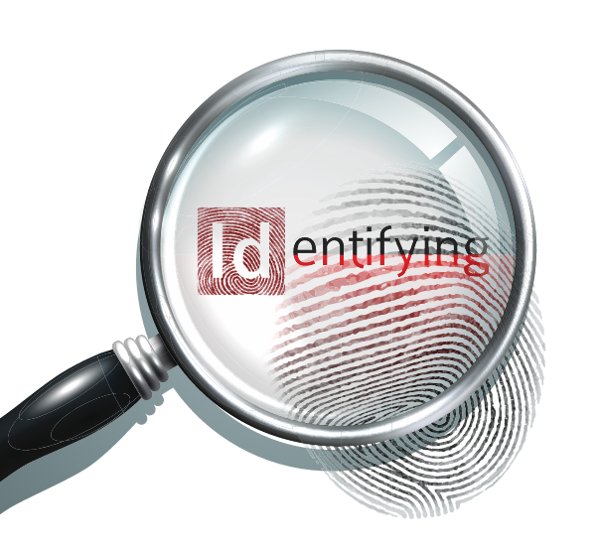
The Social Construction of Identity
There are two general frameworks through which our identities are understood:
Essentialism: Identity is something we are born with. It is our core self.
Social Constructionism: Identities are shaped by external factors such as social institutions, social structures, and people. In other words, we are shaped by society.
Magnifying glass icon by macrovector - freepik.com
Notes:
There are two general frameworks through which our identities are understood:
Essentialism: Identity is something we are born with. It is our core self.
Social Constructionism: Identities are shaped by external factors such as social institutions, social structures, and people. In other words, we are shaped by society.

Slide 8

Essentialism
According to essentialist conceptions, identity is innate; it is something with which we are born.
Essentialism is the idea that we have some kind of unchanging fundamental self.
We are all indeed biologically unique. We have our own fingerprints And from the time we are babies naturally more expressive, aggressive, or sociable than others – traits that can last throughout our lives.
Additionally, many of us naturally have distinctive talents or gifts that are nurtured over time.
But social scientists draw attention to the fact that our uniqueness does not constitute the whole, of even the major part, of our identity.
Graphics created by pch.vector - freepik.com
Notes:
According to essentialist conceptions, identity is innate; it is something with which we are born.
Essentialism is the idea that we have some kind of unchanging fundamental self.
We are all indeed biologically unique. We have our own fingerprints And from the time we are babies naturally more expressive, aggressive, or sociable than others – traits that can last throughout our lives.
Additionally, many of us naturally have distinctive talents or gifts that are nurtured over time.
But social scientists draw attention to the fact that our uniqueness does not constitute the whole, of even the major part, of our identity.

Slide 9
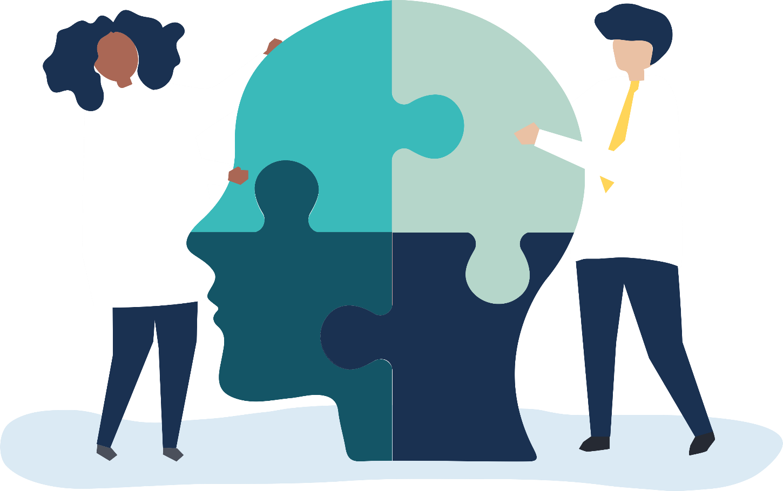
Social Constructionism
Identities are socially constructed, influenced by various external societal factors
Social constructionism reveals how our identities are the product of the interplay between individual, cultural, and social structures.
Puzzle image by rawpixel.com - freepik.com
Notes:
Identities are socially constructed, influenced by various external societal factors
Social constructionism reveals how our identities are the product of the interplay between individual, cultural, and social structures.

Slide 10
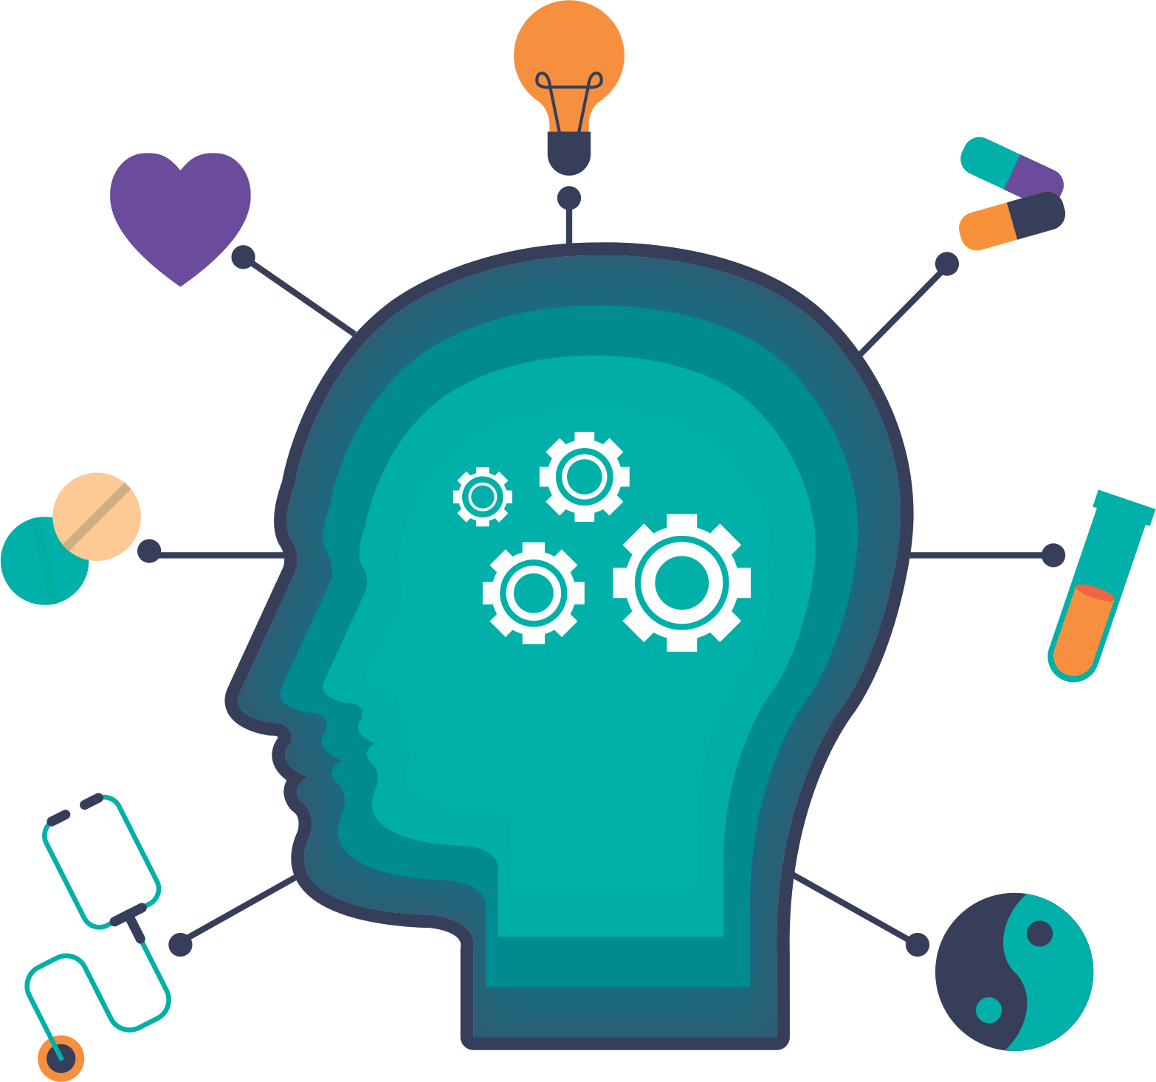
IMPORTANT NOTE
These two frameworks
essentialism
social constructionism
-- DO NOT contradict each other.
-- Rather, they co-exist in complementary ways.
Each one of us is unique. We are individuals, with our own histories, experiences, personalities, fingerprints, and so on.
However, we are also shaped by society and social expectations.
Head brain vector by freepik - freepik.com
Notes:
These two frameworks –essentialism and social constructionism -- DO NOT contradict each other.
Rather, they co-exist in complementary ways.
Each one of us is unique. We are individuals, with our own histories, experiences, personalities, fingerprints, and so on. But we are also shaped by society and social expectations.
<a href='https://www.freepik.com/vectors/head-brain'>Head brain vector created by freepik - www.freepik.com</a>

Slide 11
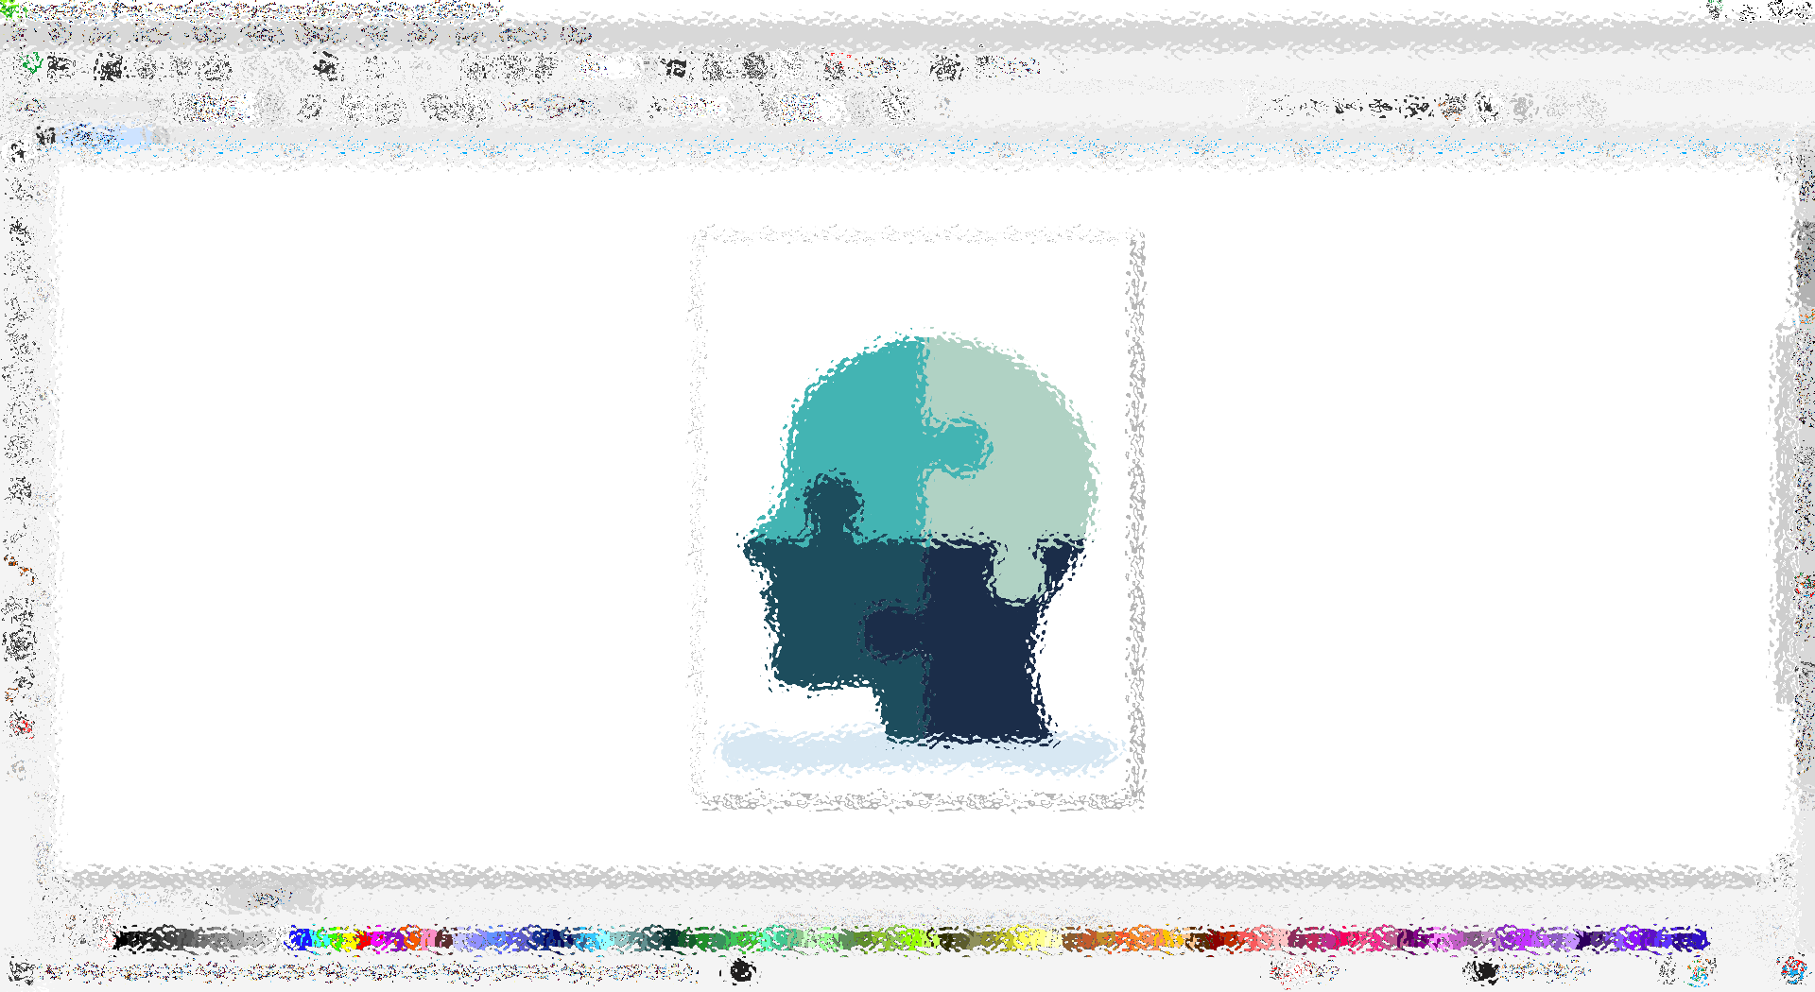
The Social Construction of Identity
In order to see how identities are socially constructed, we must understand how society functions. More specifically, we must understand the social structures that mediate our interactions.
One component of the social structure is social status.
Social Status: the position a person has in society. For example, “student,” “doctor,” “bus driver,” “police officer,” and “nurse.”
Puzzle image by rawpixel.com - freepik.com
Notes:
In order to see how identities are socially constructed, we must understand how society functions. More specifically, we must understand the social structures that mediate our interactions.
One component of the social structure is social status.
Social Status: the position a person has in society. For example, “student,” “doctor,” “bus driver,” “police officer,” and “nurse.”

Slide 12

SOCIAL STATUS
These defined positions carry a certain degree of recognition and have assigned to them very specific duties.
But social status does not just refer to occupations: “husband,” daughter,” “senior citizen,” and “addict” are also examples of a social status.
Social statuses are often divided into ascribed vs. achieved categories.
Vector by freepik - freepik.com
Notes:
These defined positions carry a certain degree of recognition and have assigned to them very specific duties.
But social status does not just refer to occupations: “husband,” daughter,” “senior citizen,” and “addict” are also examples of a social status.
Social statuses are often divided into ascribed vs. achieved categories.

Slide 13
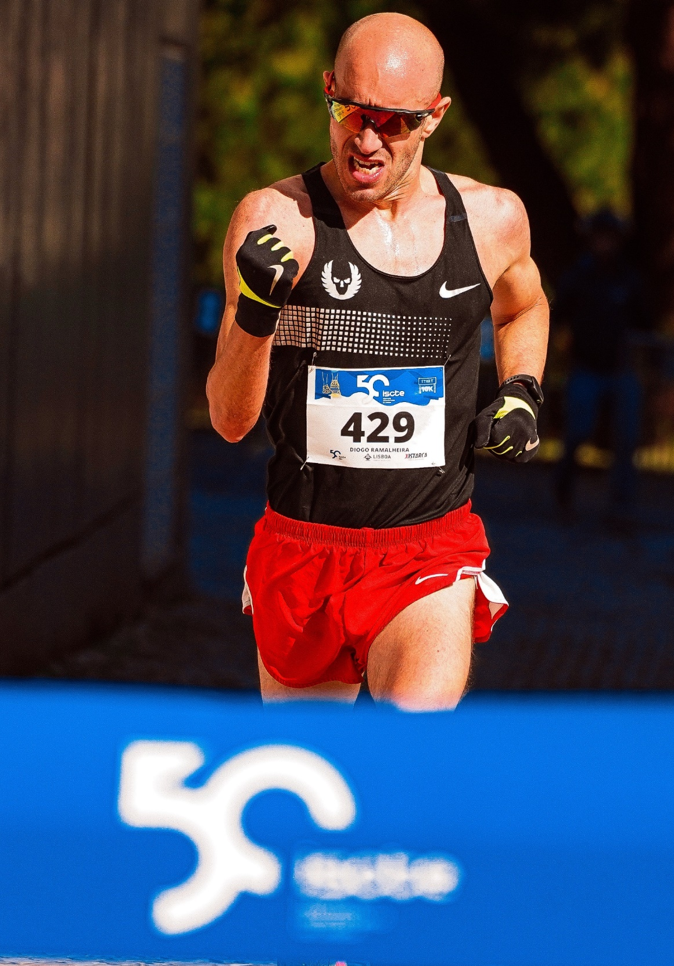
Achieved Social Status
Achieved status – a position over which one has control.
If you study hard, you can earn your status as a “straight A student.”
Photo by RUN 4 FFWPU – Pexels.com
Notes:
Achieved status – a position over which one has control.
If you study hard, you can earn your status as a “straight A student.”

Slide 14
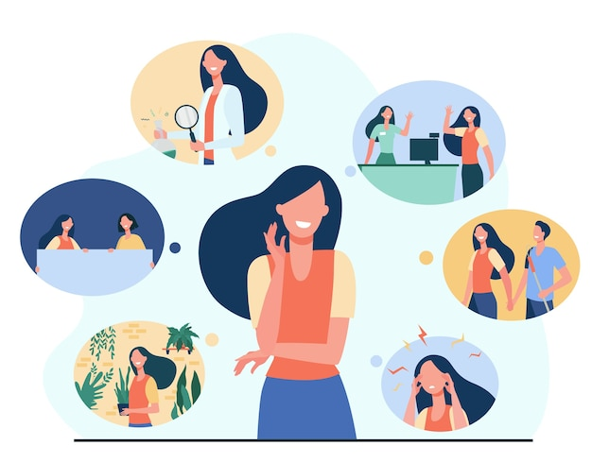
Ascribed Social Status
Ascribed status – categories assigned to individuals at birth. We have no control over these statuses.
Ethnicity, race, sex, and age are social statuses that are given to us regardless of what we may do.
Cartoon by pch.vector - freepik.com
Notes:
Ascribed status – categories assigned to individuals at birth.
We have no control over these statuses.
Ethnicity, race, sex, and age are social statuses that are given to us regardless of what we may do.

Slide 15

Ascribed vs. Achieved
One thing that is similar about both achieved and ascribed statuses,
is that society tends to assign roles to these different categories.
Photo by Anna Shvets – Pexels.com
Notes:
One thing that is similar about both achieved and ascribed statuses,
is that society tends to assign roles to these different categories.

Slide 16
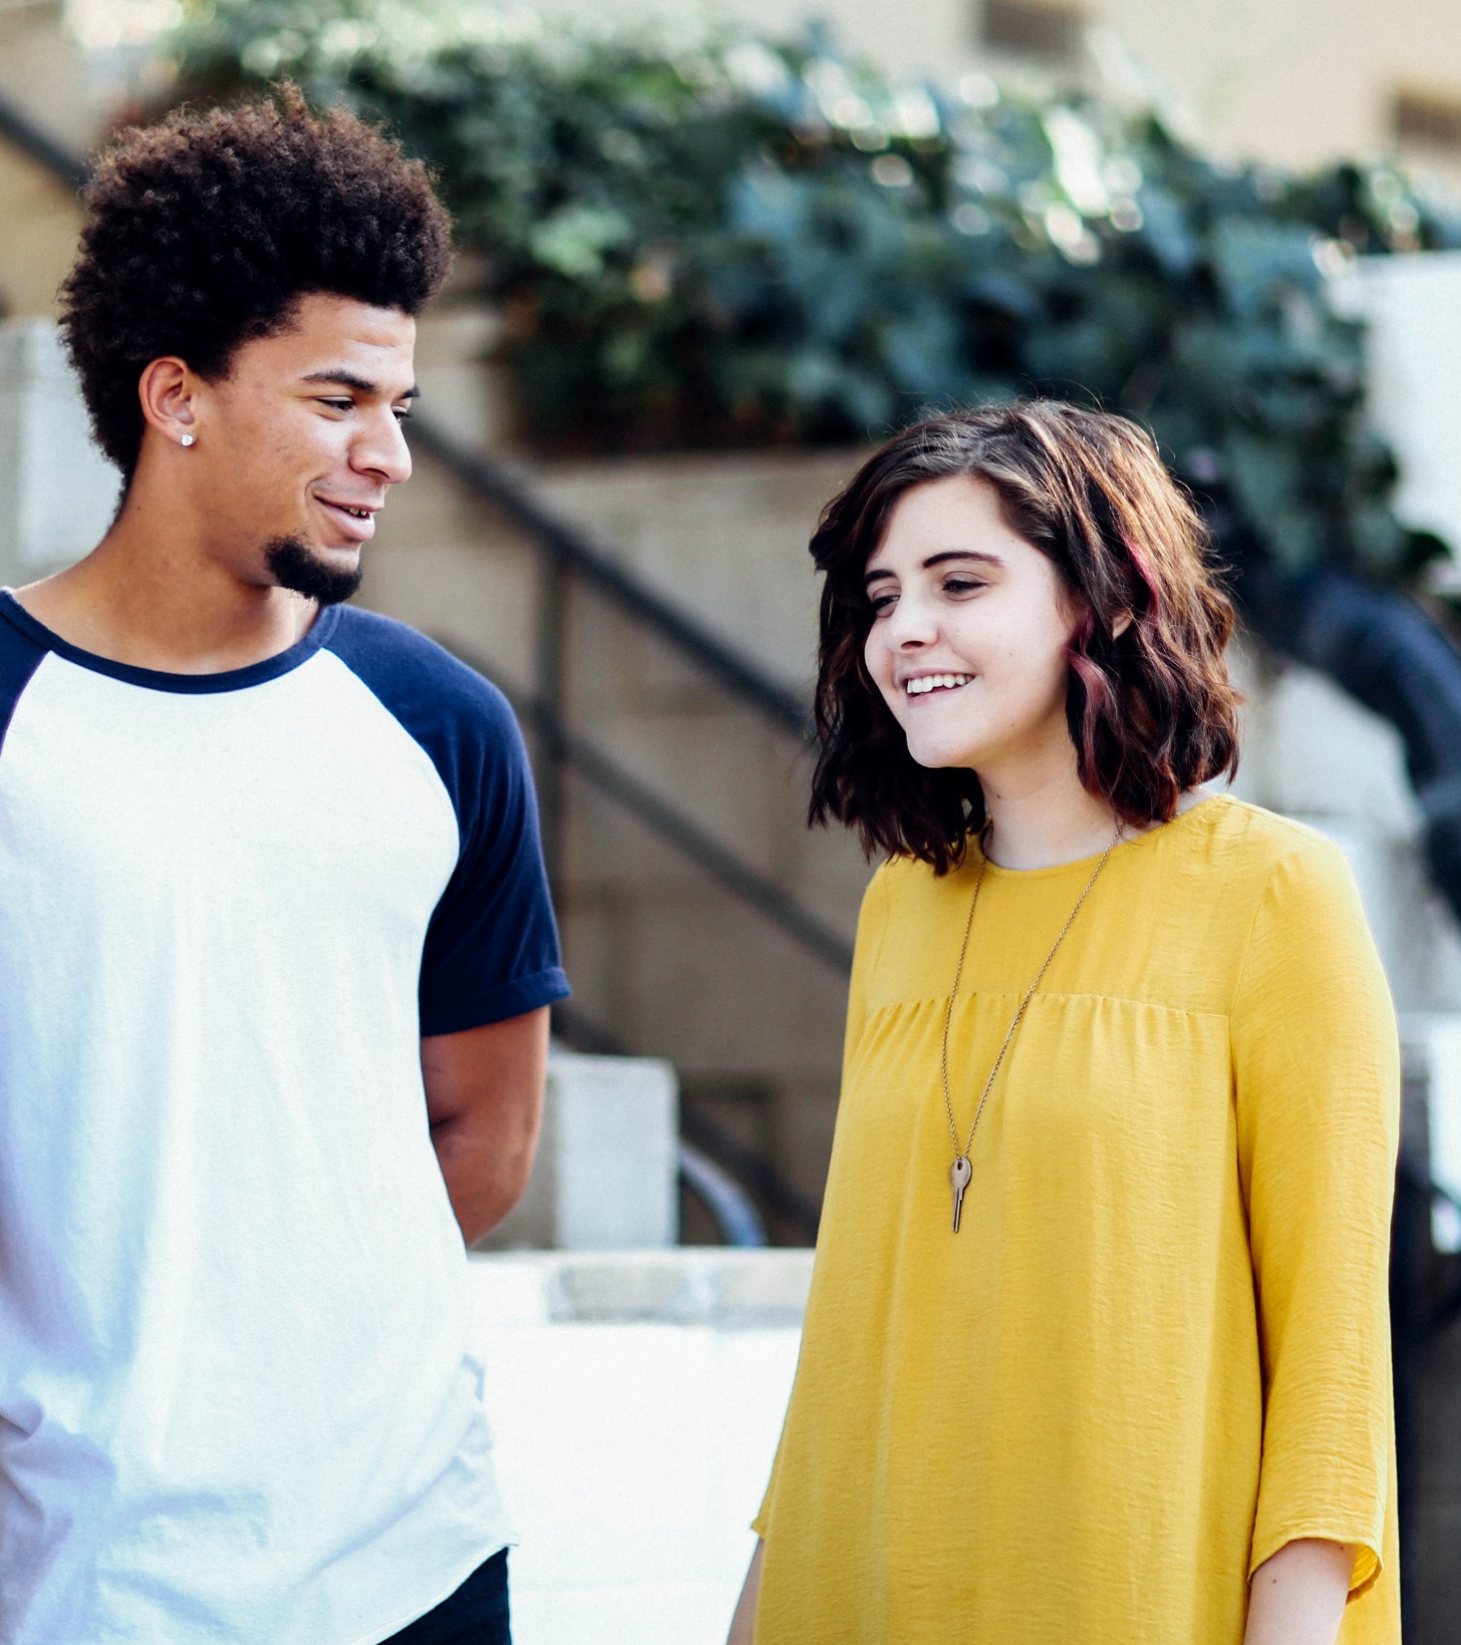
Roles
Roles: the social and behavioral expectations assigned to different status categories.
When we meet someone on the street, we may make assumptions based on their appearance and we may group them into categories familiar to us such as race, class, gender, sexuality, age, ethnicity, nationality, or occupation.
Photo by Alexis Brown on Unsplash
Notes:
Roles: the social and behavioral expectations assigned to different status categories.
When we meet someone on the street, we may make assumptions based on their appearance and we may group them into categories familiar to us such as race, class, gender, sexuality, age, ethnicity, nationality, or occupation.

Slide 17
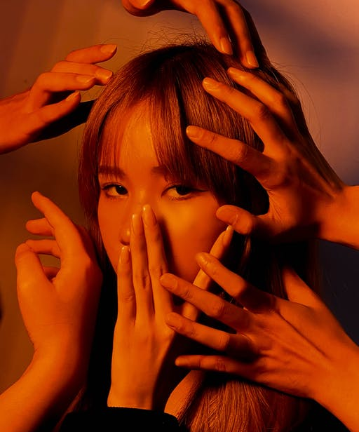
Roles
We often feel pressure (consciously or unconsciously) to conform to social expectations. Thus, if we are in school where we are categorized as “students,” we will often behave, dress, and carry ourselves according to certain expectations. When we go home and we are categorized as “parents” or “children,” our behavior, dress, attitude, and language might change because of expectations have changed.
In other words, we selectively present ourselves depending on the expectations of society.
Photo by Alycia Fung - Pexels
Notes:
We often feel pressure (consciously or unconsciously) to conform to social expectations. Thus, if we are in school where we are categorized as “students,” we will often behave, dress, and carry ourselves according to certain expectations. When we go home and we are categorized as “parents” or “children,” our behavior, dress, attitude, and language might change because of expectations have changed.
In other words, we selectively present ourselves depending on the expectations of society.

Slide 18
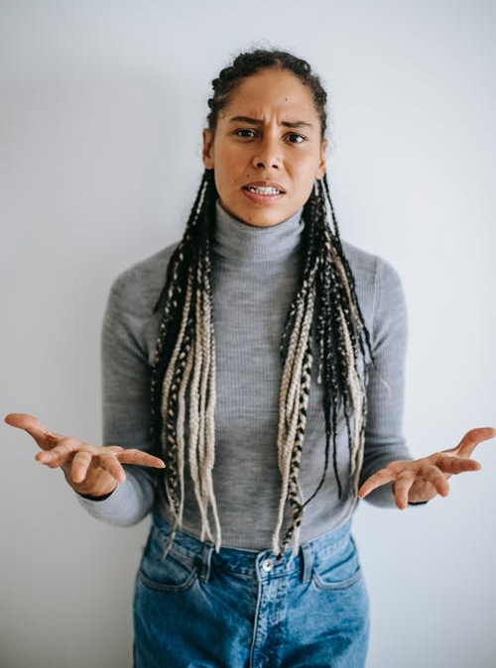
ROLES
Understanding social statuses and roles is important in the social construction of identity because the categories defined by a group or society, as well as the behavioural expectations that correspond to each category, structure both how we see ourselves and how we relate to other people.
An important part of the social construction of identity is the notion that we learn much of our identity from our families, communities, educational institutions, and other surroundings.
Over time we also learn, also without even realizing, how to selectively present ourselves to manage other people’s impressions of who we are.
Photo by Alex Green – Pexels.com
Notes:
Understanding social statuses and roles is important in the social construction of identity because the categories defined by a group or society, as well as the behavioural expectations that correspond to each category, structure both how we see ourselves and how we relate to other people.
An important part of the social construction of identity is the notion that we learn much of our identity from our families, communities, educational institutions, and other surroundings.
Over time we also learn, also without even realizing, how to selectively present ourselves to manage other people’s impressions of who we are.

Slide 19

Front-Stage & Back Stage Behaviour
According to this approach, front stage behaviour is the behaviour that we exhibit when in public or around less familiar acquaintances.
Back stage behaviour is the behaviour that we exhibit only when alone or around more intimate acquaintances.
In the front stage behaviour we are more consciously aware of how we are being perceived; whereas, in the back stage we are less anxious about how we might be judged due to our trust and familiarity with those closest to us.
Each of us unique. But we are unique within a framework made up of categories (social statuses) and expectations (roles).
Notes:
According to this approach, front stage behaviour is the behaviour that we exhibit when in public or around less familiar acquaintances.
Back stage behaviour is the behaviour that we exhibit only when alone or around more intimate acquaintances.
In the front stage we are more consciously aware of how we are being perceived; whereas, in the back stage we are less anxious about how we might be judged due to our trust and familiarity with those closest to us.
We are each of us unique. But we are unique within a framework made up of categories (social statuses) and expectations (roles).

Slide 20

Front-Stage and Back Stage Behaviour
https://www.dailymotion.com/video/x4bn77k
Notes:
Watch this video
Key & Peele - Phone Call – Comedy central
https://www.dailymotion.com/video/x4bn77k

Slide 21
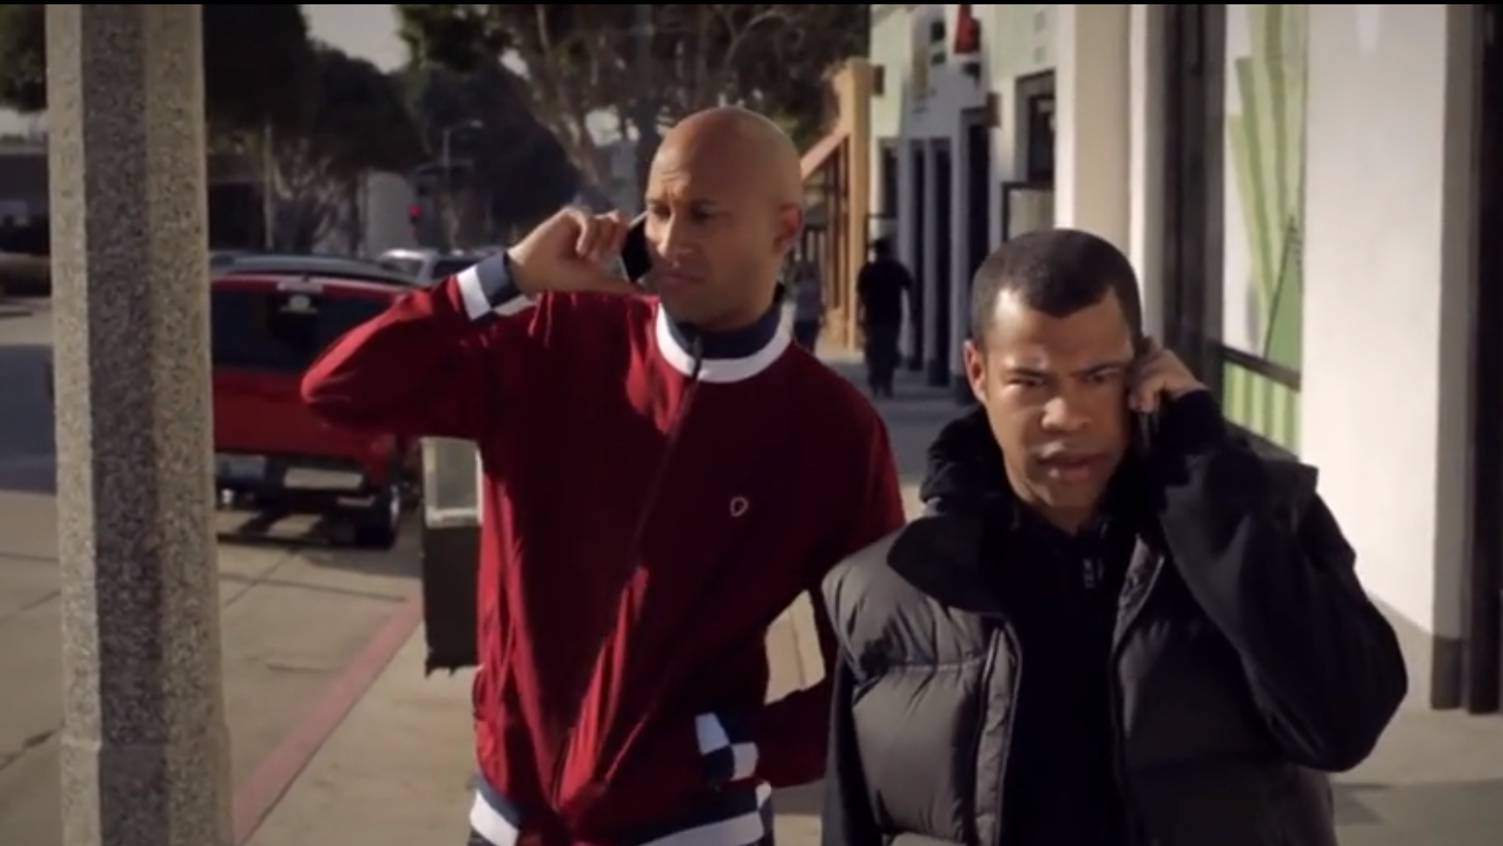
BREAK OUT SESSION
Notes:
Break Out Session: Discussion Kay and Peele Video Front Stage and Back Stage Behaviour!
When did they display front stage behaviour?
When did they display back stage behaviour?
Why do you think they acted the way they did at certain points in time in their interaction?
Discuss Societal Behaviour expectations…

Slide 22

BREAK
Photo by Pixabay from Pexels
Notes:
15 Minute Break
This slide can be moved to where you have your class break(s)

Slide 23


ATTENDANCE
ATTENDANCE MATTERS
Image by pch.vector - freepik.com
Notes:
This attendance slide can be moved to wherever in your class that you take attendance.
Usually attendance is taken around class breaks, or at the beginning or at the end of class.

Slide 24
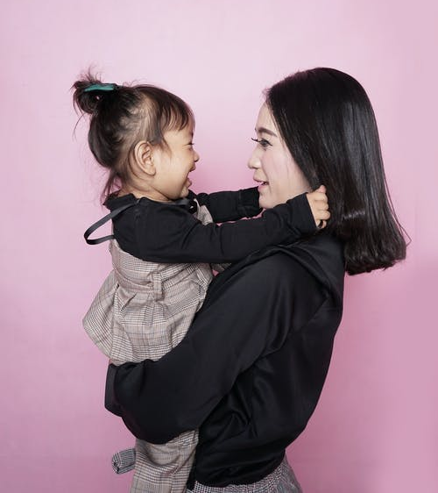
Socialization
Socialization:
The process, through interactions with others, by which we come to understand different social statuses and the roles, or behavioral expectations.
Socialization as a process begins when we are young.
Think of babies: parents spend a considerable amount of time teaching babies how and when to sleep, eat, and communicate. We are taught how to behave in society and to be aware of social expectations.
Photo by kelvin octa – Pexels.com
Notes:
Socialization: The process, through interactions with others, by which we come to understand different social statuses and the roles, or behavioral expectations.
Socialization as a process begins when we are young.
Think of babies: parents spend a considerable amount of time teaching babies how and when to sleep, eat, and communicate. We are taught how to behave in society and to be aware of social expectations.

Slide 25
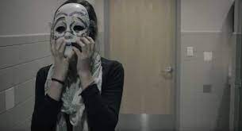
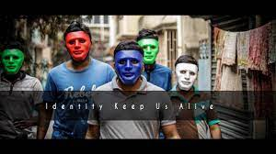
Socialization
Throughout our lives we are exposed to many agents of socialization, including: parents, schools, peer groups, families, and friends.
In high school, individuals often feel tremendous pressure to conform to the norms, attitudes, speech patterns, and dress codes of their peer groups.
Think of movies like Mean Girls or Clueless. In these movies, there are the popular girls who set the trends, and those who aspire to be like them.
IDENTITY SHORT FILM https://youtu.be/ikGVWEvUzNM
Images from Identity Short Film
Notes:
Throughout our lives we are exposed to many agents of socialization, including: parents, schools, peer groups, families, and friends.
In high school, individuals often feel tremendous pressure to conform to the norms, attitudes, speech patterns, and dress codes of their peer groups.
Think of movies like Mean Girls or Clueless. In these movies, there are the popular girls who set the trends, and those who aspire to be like them.
https://youtu.be/ikGVWEvUzNM

Slide 26
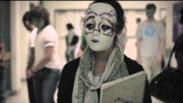

Notes:
https://youtu.be/ikGVWEvUzNM
Identity SHORT FILM
How many masks did you see
What were the masks, colors and or groups
What backgrounds and societal groups did you see
what were you able to find out about her background
What was the truth that was found

Slide 27
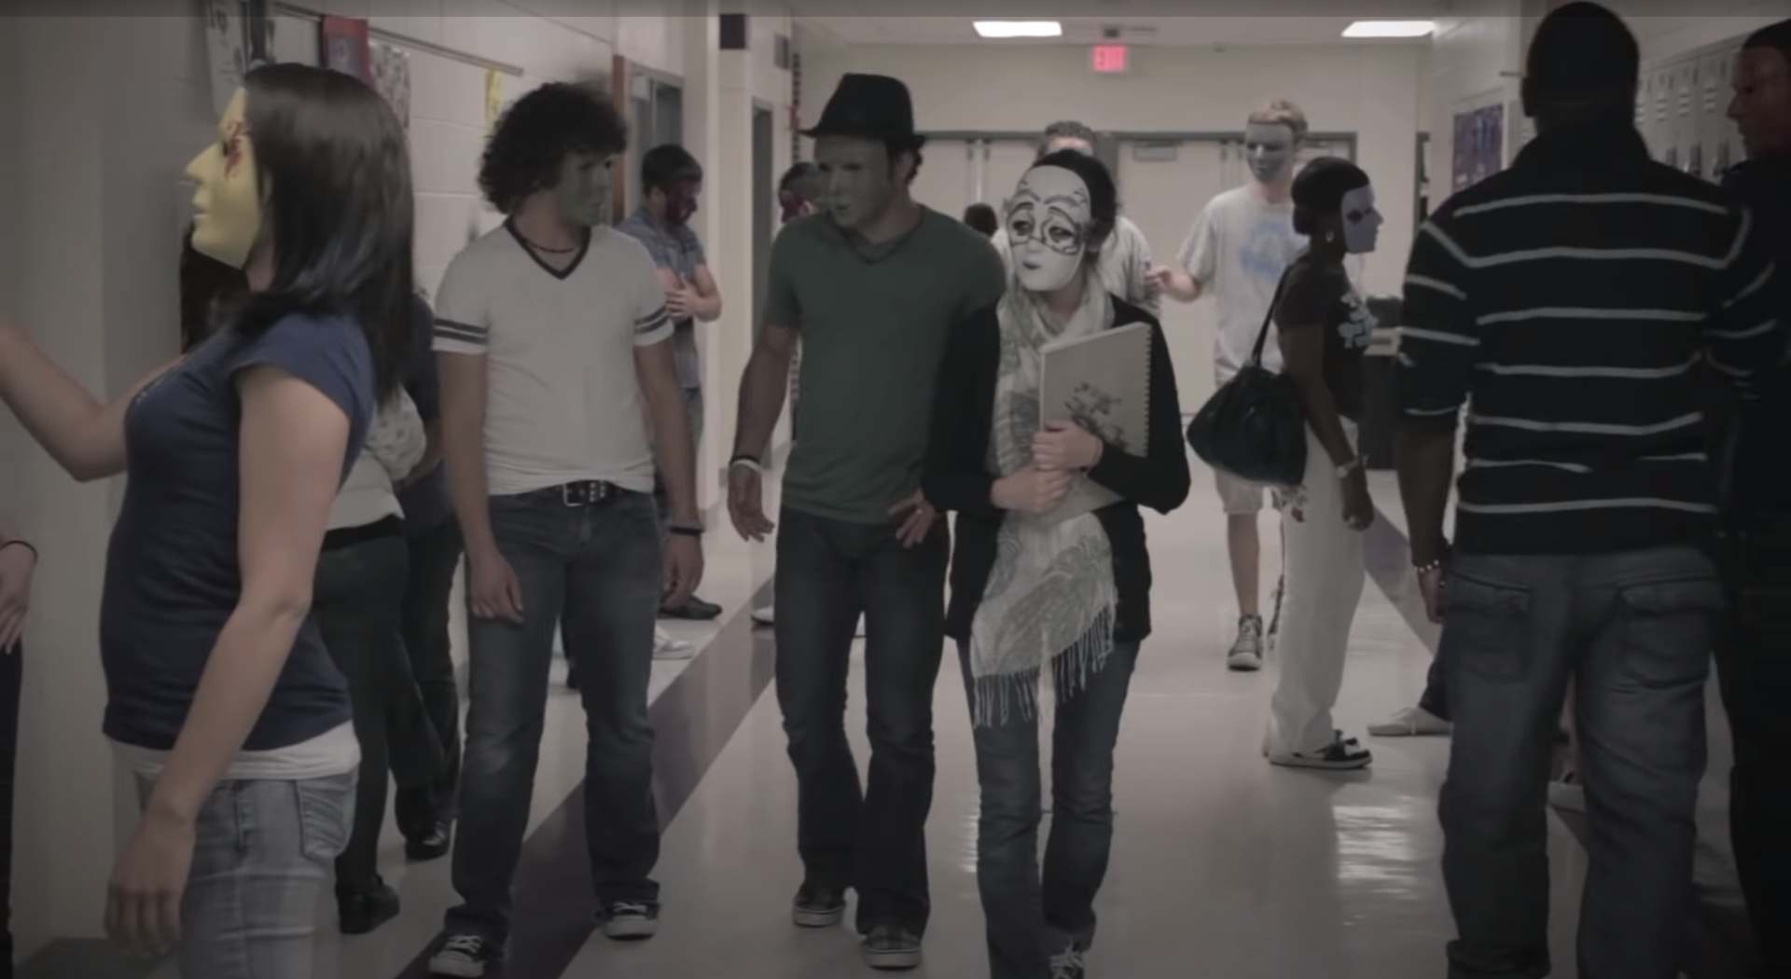
BREAK OUT SESSION : MASKS
Images from Identity Short Film
Notes:
Small Group Break Out Session Work
Each group will watch the film and then discuss the following questions.
We will then come back into the larger group for a class discussion
How many different masks did you see in total?
What were the masks, colors and groups and what did they represent?
What backgrounds and societal groups did you see in the film?
What were you able to find out the main characters background ?
What was the truth that was found ?

Slide 28
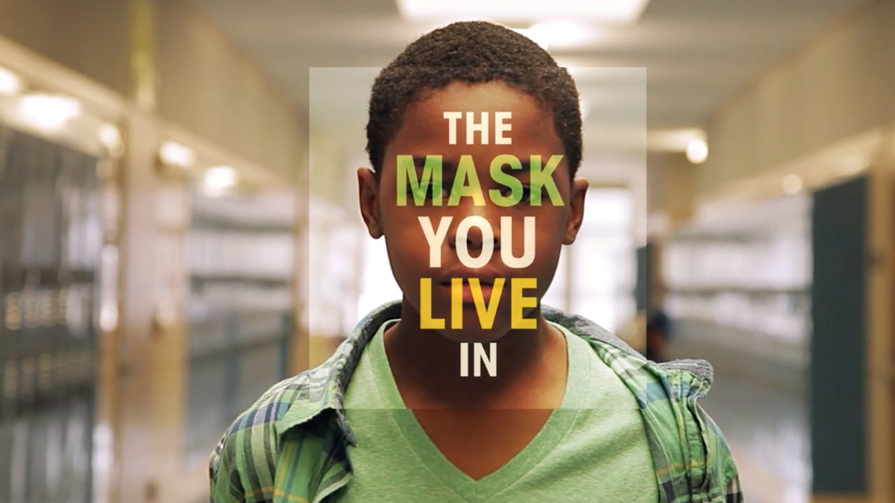
Socialization
The Mask You Live In!
A preview of boys and young men as they struggle to stay true to themselves while negotiating America’s narrow definition of masculinity.
The Mask You Live In:
http://youtu.be/hc45-ptHMxo
Image from The Mask You Live In Documentary
Notes:
The Mask You Live In.
A preview of boys and young men as they struggle to stay true to themselves while negotiating America’s narrow definition of masculinity.
Pressured by the media, their peer group, and even the adults in their lives, our protagonists confront messages encouraging them to disconnect from their emotions, devalue authentic friendships, objectify and degrade women, and resolve conflicts through violence. These gender stereotypes interconnect with race, class, and circumstance, creating a maze of identity issues boys and young men must navigate to become “real” men.
Experts in neuroscience, psychology, sociology, sports, education, and media also weigh in, offering empirical evidence of the “boy crisis” and tactics to combat it.
The Mask You Live In ultimately illustrates how we, as a society, can raise a healthier generation of boys and young men.

Slide 29

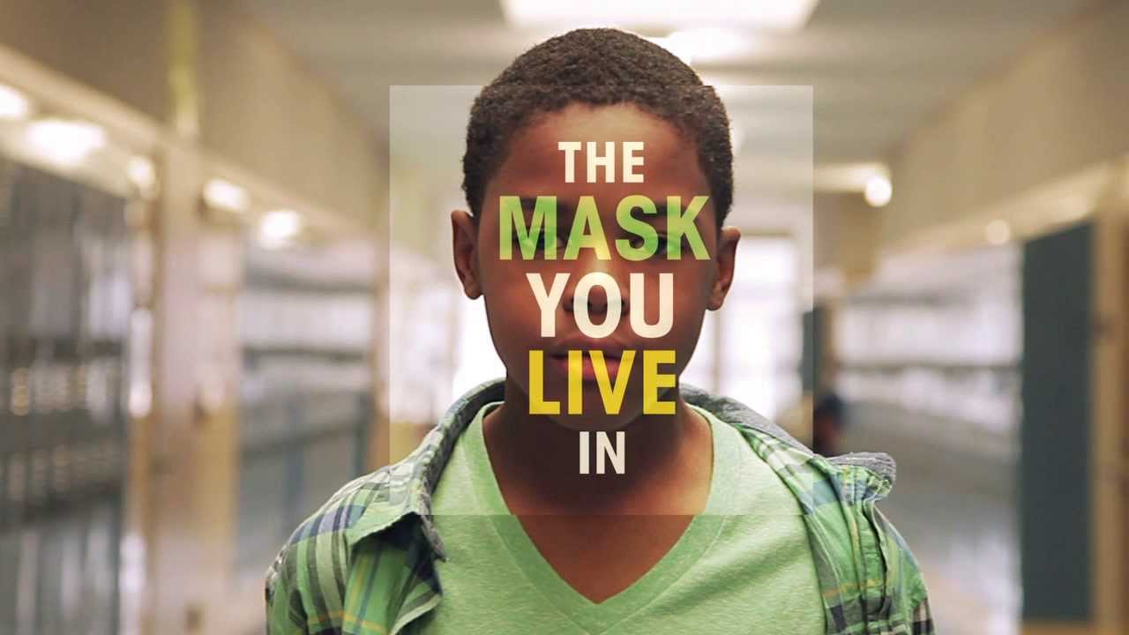
Notes:
The Mask You Live In.
A preview of boys and young men as they struggle to stay true to themselves while negotiating America’s narrow definition of masculinity.
Pressured by the media, their peer group, and even the adults in their lives, our protagonists confront messages encouraging them to disconnect from their emotions, devalue authentic friendships, objectify and degrade women, and resolve conflicts through violence. These gender stereotypes interconnect with race, class, and circumstance, creating a maze of identity issues boys and young men must navigate to become “real” men.
Experts in neuroscience, psychology, sociology, sports, education, and media also weigh in, offering empirical evidence of the “boy crisis” and tactics to combat it.
The Mask You Live In ultimately illustrates how we, as a society, can raise a healthier generation of boys and young men.
https://youtu.be/hc45-ptHMxo
Discuss as a class the effect of Toxic Masculinity and Gender Roles on Society

Slide 30
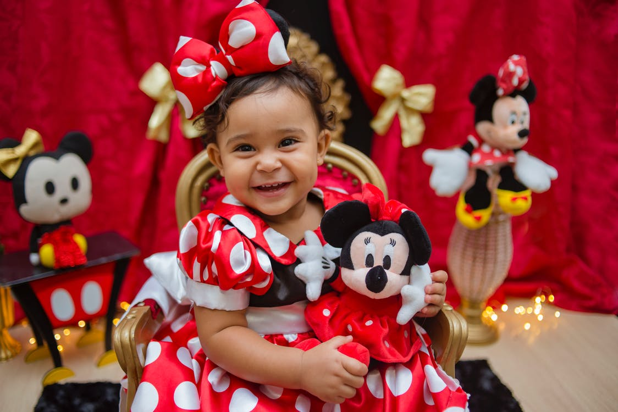
Socialization & The Media
One of the most powerful socializing influences on our identities is the mass media.
In Canada, both children and adults spend thousands of hours every year watching television, surfing the Internet, and listening to music.
We have more choice than ever in the types and amount of media we consume, however the media sends powerful messages about our values, beliefs, and position in society.
The following video considers how Disney movies shape children
Photo by Monique Pinto - Pexels.com
Notes:
One of the most powerful socializing influences on our identities is the mass media. In Canada, both children and adults spend thousands of hours every year watching television, surfing the Internet, and listening to music. While we have ever more choice in the types and amount of media we consume, the media sends powerful messages about our values, beliefs, and position in society.
The following video considers how Disney movies shape children: http://www.youtube.com/watch?v=byaMd_PNyIY
Socialization is very influential in the way we determine our identities, but people are not simply passive recipients of the messages they receive about who they are and how they should act.
We exert some agency, particularly in the way we present our identity to others.
Each of us make choices about how we conform to the categories and expectations place upon us.
Much of our identity is formed through a process of noticing how others see us and reflecting on how we see ourselves and how we would like to be seen.
Discuss as a class the effect Media like Disney has on Society.

Slide 31
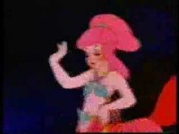
Notes:
The following video considers how Disney movies shape children: http://www.youtube.com/watch?v=byaMd_PNyIY

Slide 32
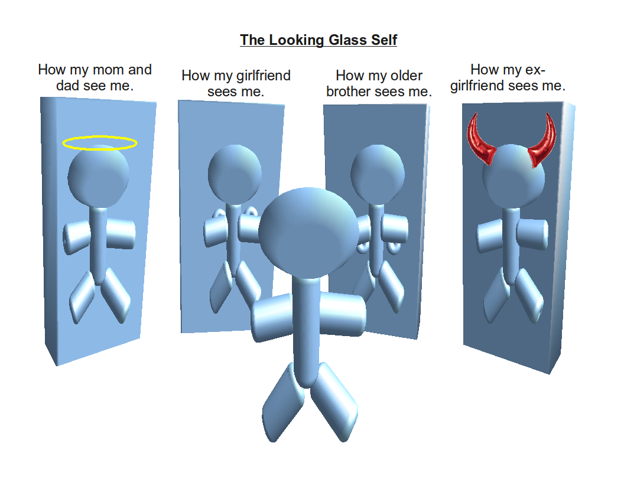
The Looking-Glass Self
The looking-glass self is a theory by Charles Horton Cooley that claims that our identities are formed through the way we imagine we are seen by others.
We imagine how our personality and appearance seem to other people and how they might judge us and we adjust our identity (or self-concept) accordingly.
Looking glass self Wikimedia CC-BY-3.0
Notes:
The looking-glass self is a theory by Charles Horton Cooley that claims that our identities are formed through the way we imagine we are seen by others.
We imagine how our personality and appearance seem to other people and how they might judge us and we adjust our identity (or self-concept) accordingly.

Slide 33
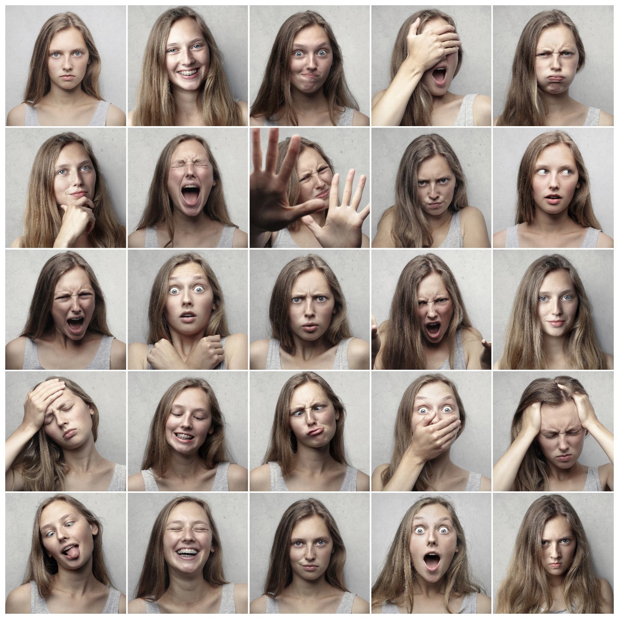
The Looking-Glass Self
How others See you?
How are you are actually seen?
How do you want to be seen?
Photo by Andrea Piacquadio:- Pexels.com
Notes:
The Looking-Glass Self
How others See you?
How are you are actually seen?
How do you want to be seen?

Slide 34
BREAK
Photo by Pixabay from Pexels
Notes:
15 Minute Break
This slide can be moved to where you have your class break(s)

Slide 35
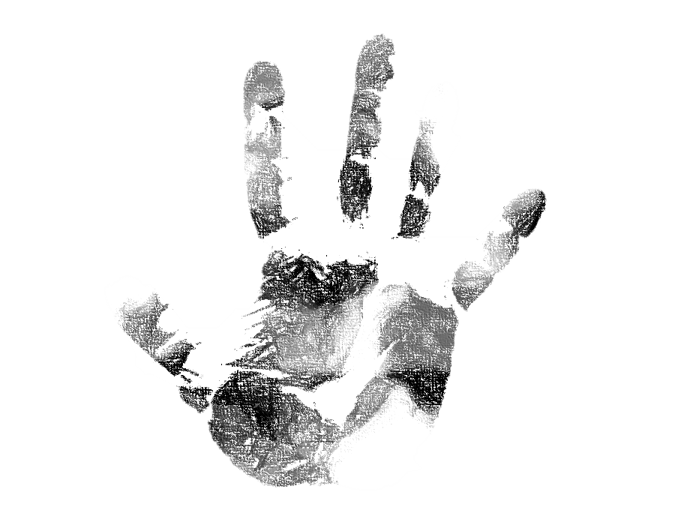


IDENTITY AND SOCIAL CONTEXT
In this module, we will look at the ways in which our identities are fluid rather than static.
We will consider how they are shaped by the social, historical, and ideological forces around us.
The previous module asked the question, was your identity given to you or was it created?
In this module, we go further by asking,
Who would you be if you were never socialized by society?
How do we learn to perform our identity?
Artwork by Hi Profile is licensed under a CC BY-NC-SA 4.0 International License.
Notes:
In this module, we will look at the ways in which our identities are fluid rather than static.
We will consider how they are shaped by the social, historical, and ideological forces around us.
The previous module asked the question, was your identity given to you or was it created?
In this module, we go further by asking,
Who would you be if you were never socialized by society?
How do we learn to perform our identity?

Slide 36
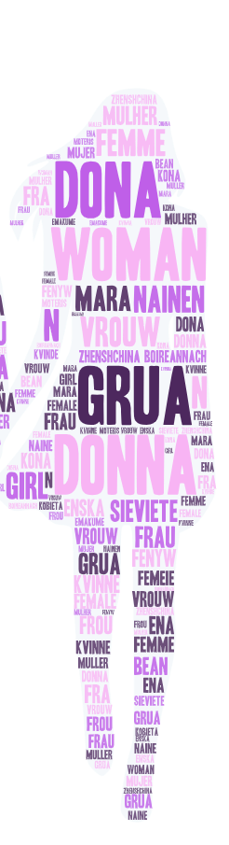
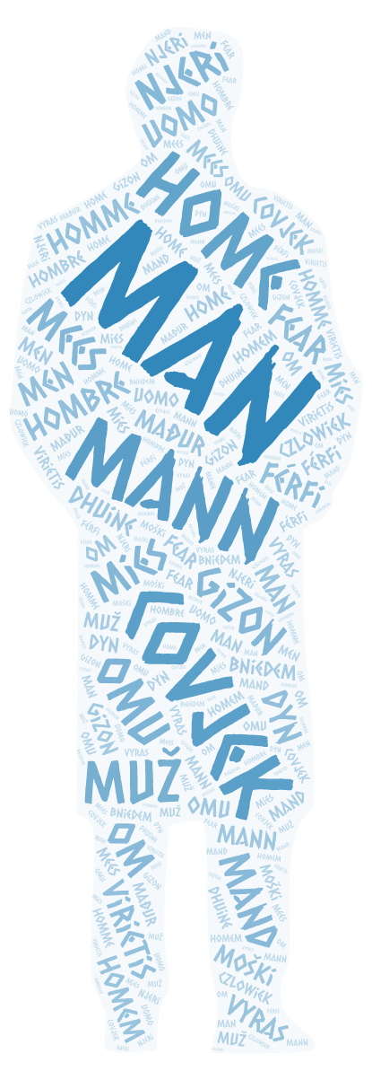
Social Construct OF GENDER
In order to understand gender identities as socially constructed, we have to begin with a distinction between sex and gender.
Sex: the biological differences between male and female.
These categories are not always as discrete as they may seem.
Intersex: refers to people who have both male and female genital characteristics.
Gender: refers to the characteristics of being “masculine” and being “feminine.”
Generally, we think of “male” as “masculine” and “female” as “feminine.”
Artwork by Hi Profile is licensed under a CC BY-NC-SA 4.0 International License.
Notes:
In order to understand gender identities as socially constructed, we have to begin with a distinction between sex and gender.
Sex: the biological differences between male and female.
These categories are not always as discrete as they may seem.
Intersex: refers to people who have both male and female genital characteristics.
Gender: refers to the characteristics of being “masculine” and being “feminine.”
Usually, we think of “male” as “masculine” and “female” as “feminine.”

Slide 37
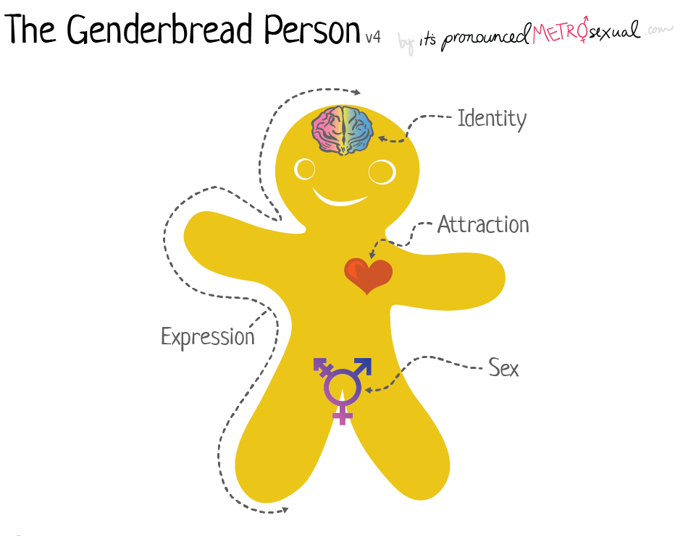
GENDER: THE GENDERBREAD PERSON
Genderbread Person Version 4 created and uncopyrighted 2017 by Sam Killermann
Notes:
https://www.genderbread.org/resource/genderbread-person-v4-0
A teaching tool for breaking the big concept of gender down into bite-sized, digestible pieces
By Sam Killermann from https://www.genderbread.org

Slide 38

GENDER
Genderbread Person Version 4 created and uncopyrighted 2017 by Sam Killermann
Notes:
https://www.genderbread.org/resource/genderbread-person-v4-0
A teaching tool for breaking the big concept of gender down into bite-sized, digestible pieces
By Sam Killermann from https://www.genderbread.org

Slide 39
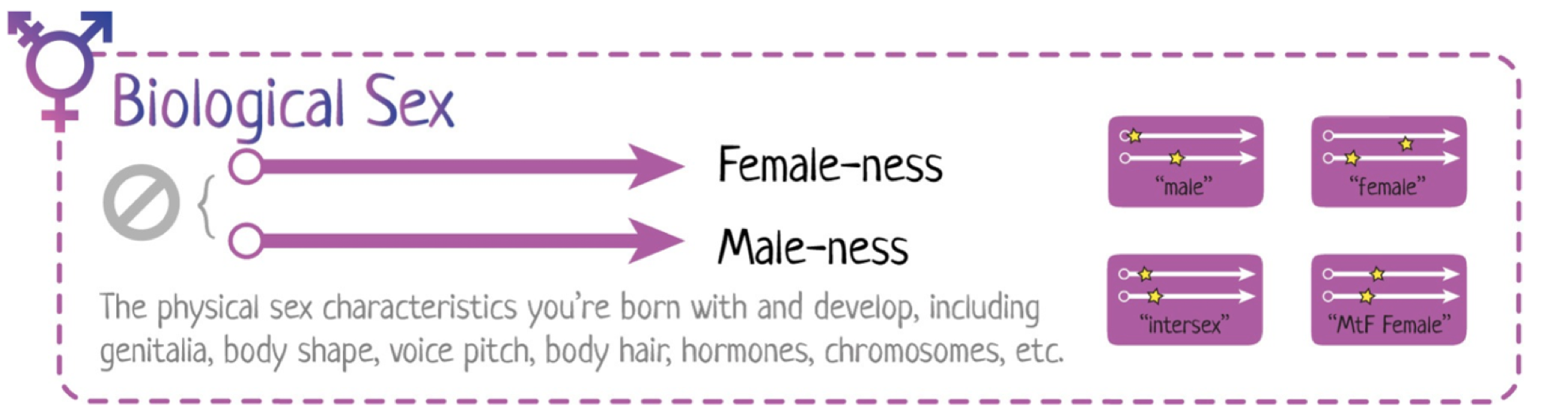
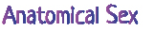
ANATOMICAL SEX
Genderbread Person Version 4 created and uncopyrighted 2017 by Sam Killermann
Notes:
In order to understand gender identities as socially constructed, we have to begin with a distinction between sex and gender.
Sex: the biological differences between male and female.

Slide 40
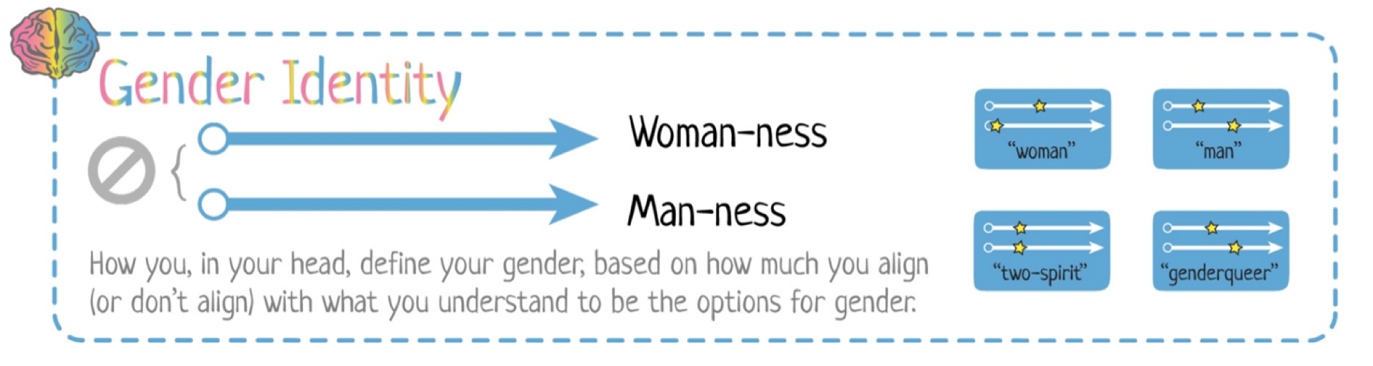
GENDER IDENTITY
Genderbread Person Version 4 created and uncopyrighted 2017 by Sam Killermann
Notes:
How we feel on the inside (how masculine or feminine we feel).
This is called gender identity.
It can be described as our Women-ness or out Man-ness

Slide 41
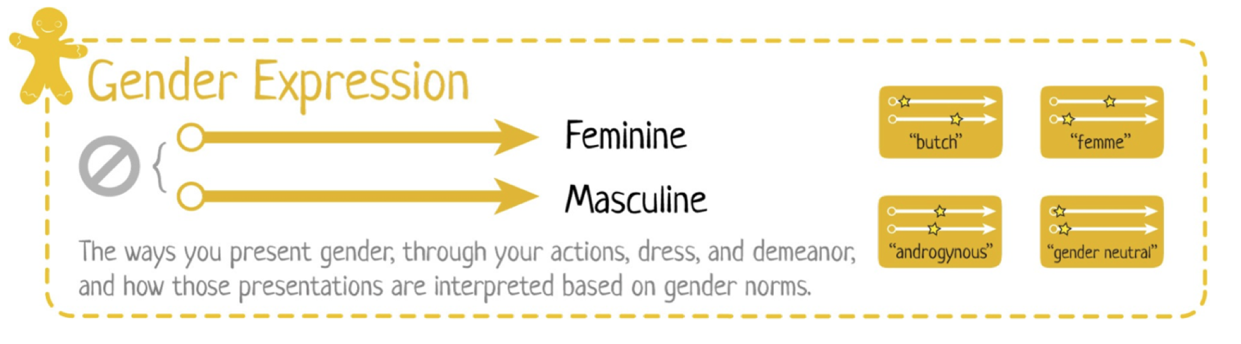
GENDER EXPRESSION
Genderbread Person Version 4 created and uncopyrighted 2017 by Sam Killermann
Notes:
How we express it on the outside (for example, how masculine or feminine we dress – remember this can change in different social contexts). This is called gender expression.
People express their masculinity or femininity in different ways, but the stories we tell in our culture, for example through the media, often rely on stereotypical, codified expressions of gender.

Slide 42
ATTRACTION
Genderbread Person Version 4 created and uncopyrighted 2017 by Sam Killermann
Notes:
Sexual and romantic attraction are different.
Sexual attraction comes from a sexual desire for something or someone,
while romantic attraction is the want to have a romantic relationship with someone outside of sex.
Feeling sexually and/or romantically attracted to someone means different things for different people.
Perhaps you feel sexually attracted to multiple or all genders, but only desire to seriously date certain genders.
Take asexual people, who often don't feel a sense of sexual attraction but may enjoy having romantic relationships with others.
Or aromantic folks who may enjoy having sex but may not have a desire to be in a romantic partnership.

Slide 43

Sexuality
Sexuality: refers to sexual preferences and orientation.
Just as we have expectations of appropriate gender roles, we also have expectations of appropriate sexual roles.
Men are expected to be sexually aggressive, women to be passive.
Women who assert themselves sexually are called “sluts.”
The socially acceptable sexual roles not only work to limit and police appropriate sexual behaviors, they also feed into assumptions that women and men must be naturally attracted to the opposite sex.
We assume that sexuality is synonymous with heterosexuality.
As such, we often assume that heterosexuality is “normal” and “natural” while homosexuality is framed as “deviant” and “unnatural.
People who fail to conform to acceptable sexual roles are often punished. For instance, gays and lesbians are often the target of discrimination.
Photo by Pixabay

Slide 44
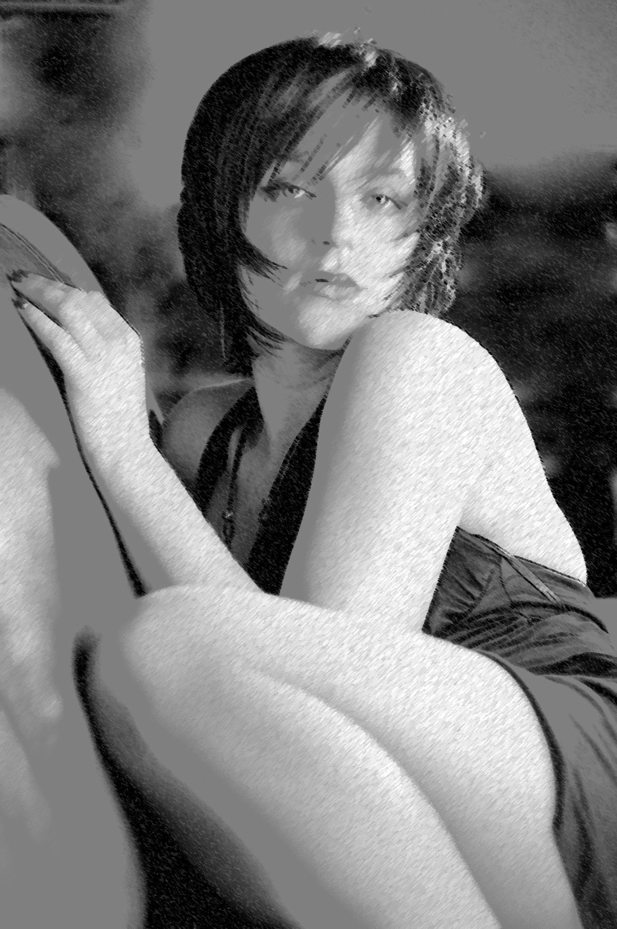
Gender Performativity
Judith Butler, a well known theorist of gender and performativity, argues that the assumption that “gender is the rightful property of sex, that ‘masculine’ belongs to ‘male’ and ‘feminine’ belongs to ‘female’ is false.
Gender is something we learn. It is not something we are born with. From the time we are young, girls are taught to wear pink and to play with dolls while boys are taught to wear blue and to play with trucks.
Image by PassionArt from Pixabay
Notes:
Judith Butler, a well known theorist of gender and performativity, argues that the assumption that “gender is the rightful property of sex, that ‘masculine’ belongs to ‘male’ and ‘feminine’ belongs to ‘female’ is false.
Men may not necessarily feel or act “masculine” and women may not necessarily feel or act “feminine.” Think of tom boys.
Gender is something we learn. It is not something we are born with. From the time we are young, girls are taught to wear pink and to play with dolls while boys are taught to wear blue and to play with trucks.

Slide 45
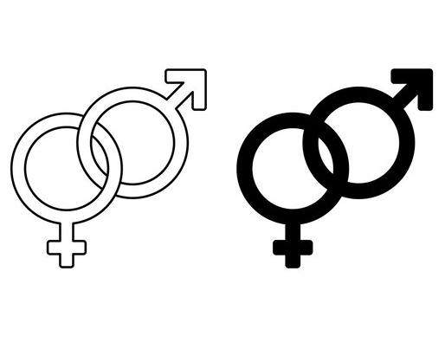
GENDER SOCIALIZATION
Socialization is how girls and boys in our culture learn about and internalize gendered beliefs, values, and practices.
This process is how we actively formulate ideas about who we are and how we're supposed to act (and not act).
Males and females are socialized very differently in most cultures. As a result of this socialization, stereotypes are often formed.
Gender symbols by freepik.com
Notes:
Gender stereotyping is the process in which children's biological sex determines the activities they engage in (and not engage in),
Girls have not been as encouraged by parents to be physically active.
Girls are less apt to be taught and to engage in fundamental motor skills during their young sensitive periods

Slide 46

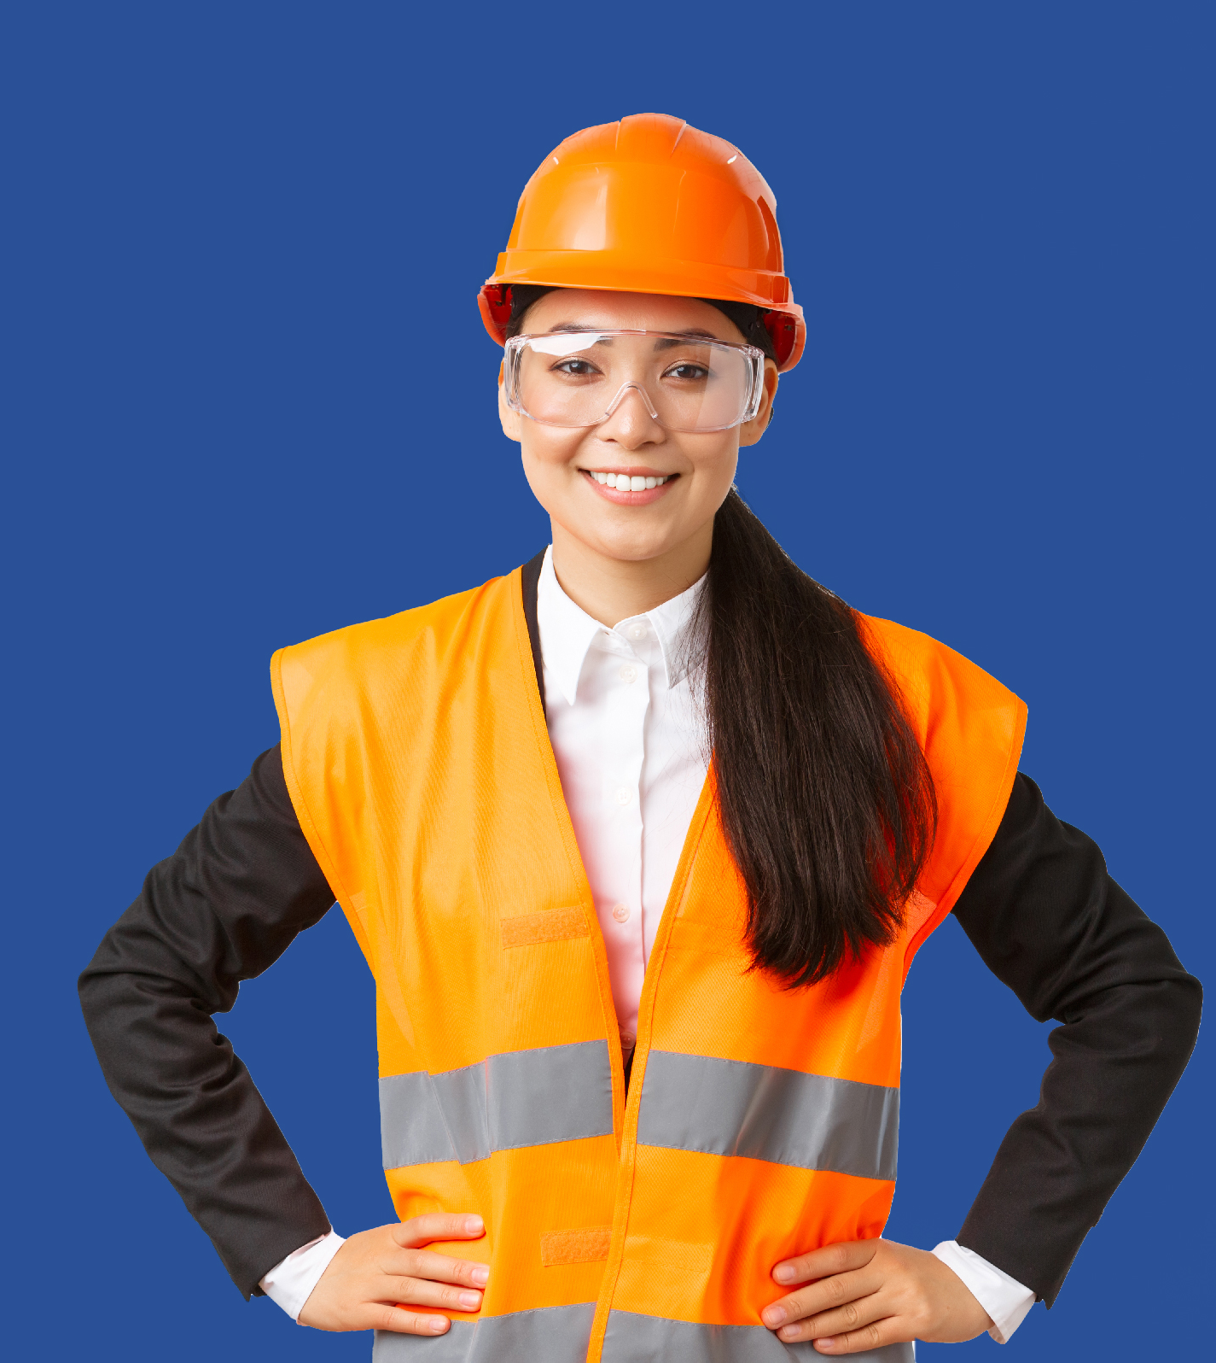
Gendered Stereotypes
Photo by benzoix - freepik.com
Photo by benzoix - freepik.com
Notes:
Gender stereotyping refers to the practice of ascribing to an individual woman or man specific attributes, characteristics, or roles by reason only of their membership in the social group of being a woman or man. Gender stereotyping is wrong and can result in a violation or violations of human rights and fundamental freedoms.
Indeed, both men and women are often represented according to their gendered stereotypes in media and advertisements.
A gender stereotype is a generalized view or preconception about attributes or characteristics, or the roles that are or ought to be possessed by, or performed by, women and men.
What story is the image telling? What thoughts come to mind?
Remember that representation is not only about who is portrayed, but also how they are portrayed.
<a href='https://www.freepik.com/photos/background'>Background photo created by benzoix - www.freepik.com</a><a href='https://www.freepik.com/photos/background'>Background photo created by benzoix - www.freepik.com</a>

Slide 47
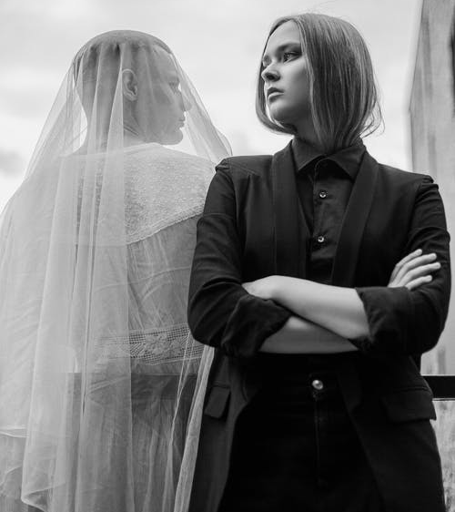
GENDER ROLES
Gender, unlike sex, is a social construct and we are socialized into gender roles through that construct.
From a very young age, boys are taught to be boys, while girls are taught to be girls.
Whereas girls are encouraged to be “cute” and “sweet,” boys are encouraged to be “aggressive” and “strong.”
The important thing to note is that those who fail to comply to their gender as seen by society are often bullied, called names, and mistreated.
Photo by Евгений Горман from Pexels.com
Notes:
Gender, unlike sex, is a social construct and we are socialized into gender roles through that construct.
From a very young age, boys are taught to be boys, while girls are taught to be girls.
Whereas girls are encouraged to be “cute” and “sweet,” boys are encouraged to be “aggressive” and “strong.”
The important thing to note is that those who fail to comply to their gender as seen by society are often bullied, called names, and mistreated.

Slide 48
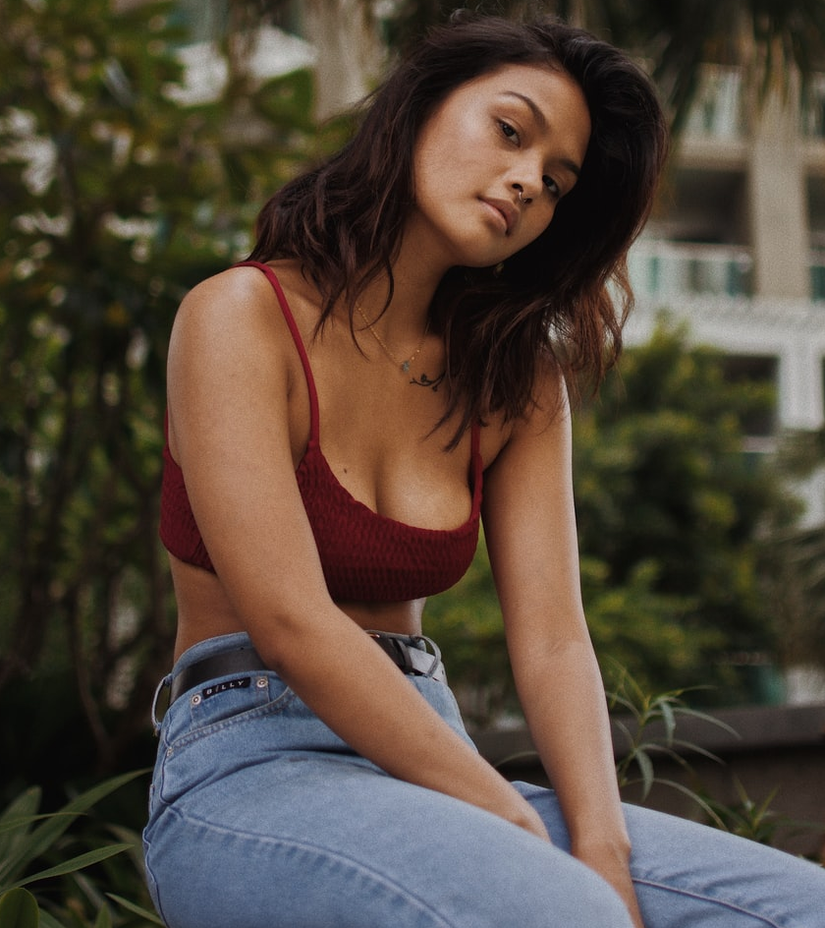
Gender and Power
Masculinity is stereotypically associated with the qualities of being strong, rational, independent, intelligent, and aggressive.
Femininity is typically associated with the qualities of being nurturing, emotional, weak, kind, maternal, etc.
These stereotypes can feed into gender inequality.
In the workplace, for example, men will often occupy more positions of power than women because they are assumed to more intelligent and more powerful than their female counterparts.
Photo by Joshua Rawson-Harris on Unsplash
Notes:
Masculinity is stereotypically associated with the qualities of being strong, rational, independent, intelligent, and aggressive.
Femininity is typically associated with the qualities of being nurturing, emotional, weak, kind, maternal, etc.
These stereotypes can feed into gender inequality.
In the workplace, for example, men will often occupy more positions of power than women because they are assumed to more intelligent and more powerful than their female counterparts.

Slide 49

Notes:
Let’s look at a daily task: dressing ourselves.
This is taken from 100 years of fashion
https://youtu.be/L3e8MvTntkE
How does our gender affect the clothes we choose?
What is considered fashion for men and fashion for women?
Who decides what is appropriate to wear as a man or woman?
How does western culture affect fashion and our fashion choices?
How does religion affect our cultural fashion choices?
These questions reveal the role media, culture, family, religion and educational institutions play in how we perform our gender and how we are rewarded for that performance.

Slide 50
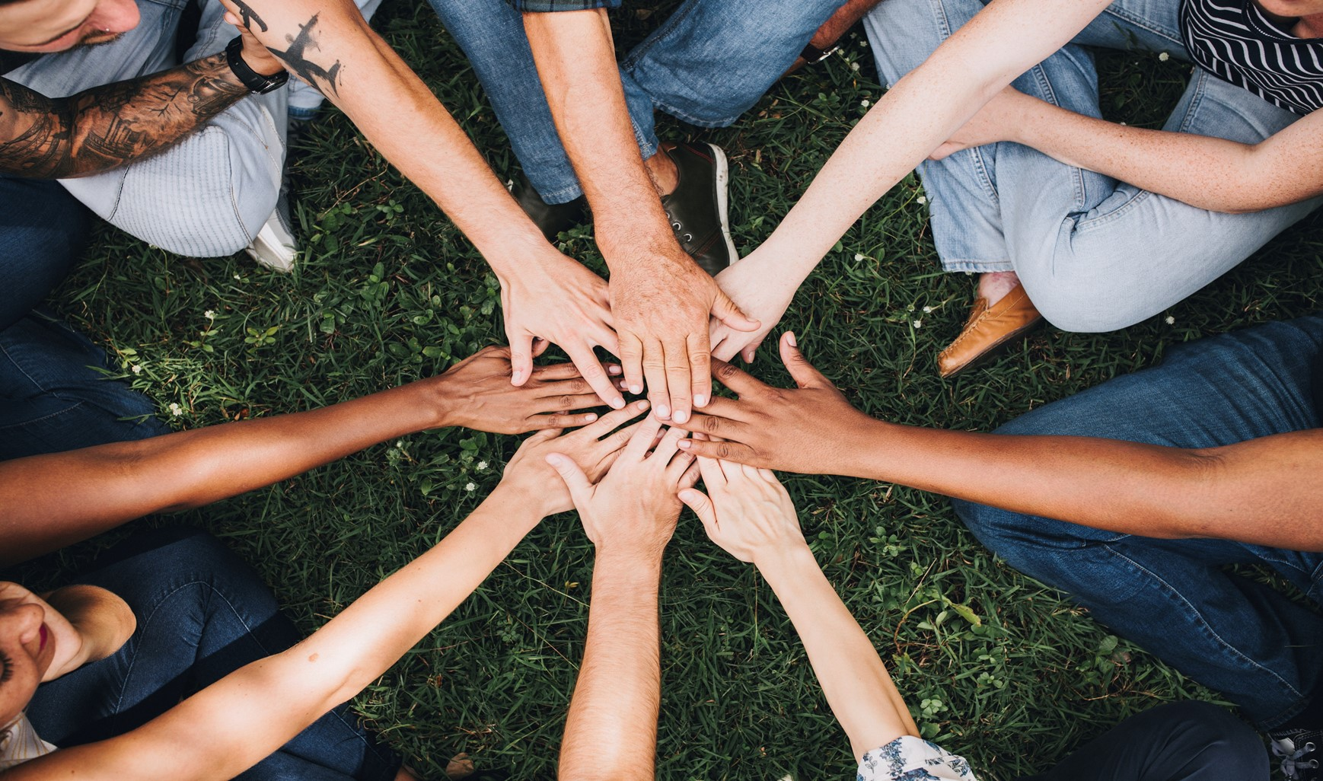
BREAKOUT GROUPS
Photo by rawpixel.com - freepik.com
Notes:
In small groups discuss
How does our gender affect the clothes we choose?
What is considered fashion for men and fashion for women?
Who decides what is appropriate to wear as a man or woman?
How does western culture affect fashion and our fashion choices?
How does religion affect our cultural fashion choices?
These questions reveal the role media, culture, family, religion and educational institutions play in how we perform our gender and how we are rewarded for that performance.

Slide 51
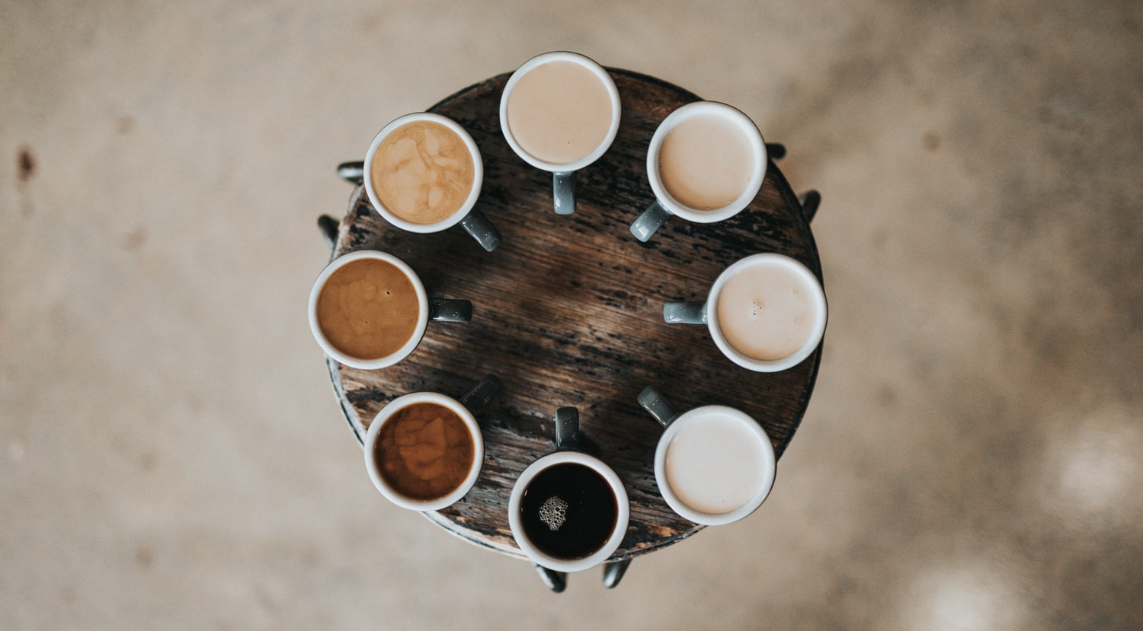
BREAK
Photo by Nathan Dumlao on Unsplash
Notes:
15 Minute Break
This slide can be moved to where you have your class break(s)

Slide 52

Intersectionality
People can be discriminated against based on statuses such as gender, race, sexuality, ethnicity, culture, class, caste, religion, (dis)ability, body size and shape, etc.
People are often discriminated against based on two or more statuses. We could be disadvantaged based on gender and ability, or race and sexuality, or any combination of the above.
Academics and activists refer to the experience of discrimination from a number of different directions as intersectionality.
Image by Ryan McGuire from Pixabay
Notes:
People can be discriminated against based on statuses such as gender, race, sexuality, ethnicity, culture, class, caste, religion, (dis)ability, body size and shape, etc.
People are often discriminated against based on two or more statuses. We could be disadvantaged based on gender and ability, or race and sexuality, or any combination of the above.
Academics and activists refer to the experience of discrimination from a number of different directions as intersectionality.

Slide 53
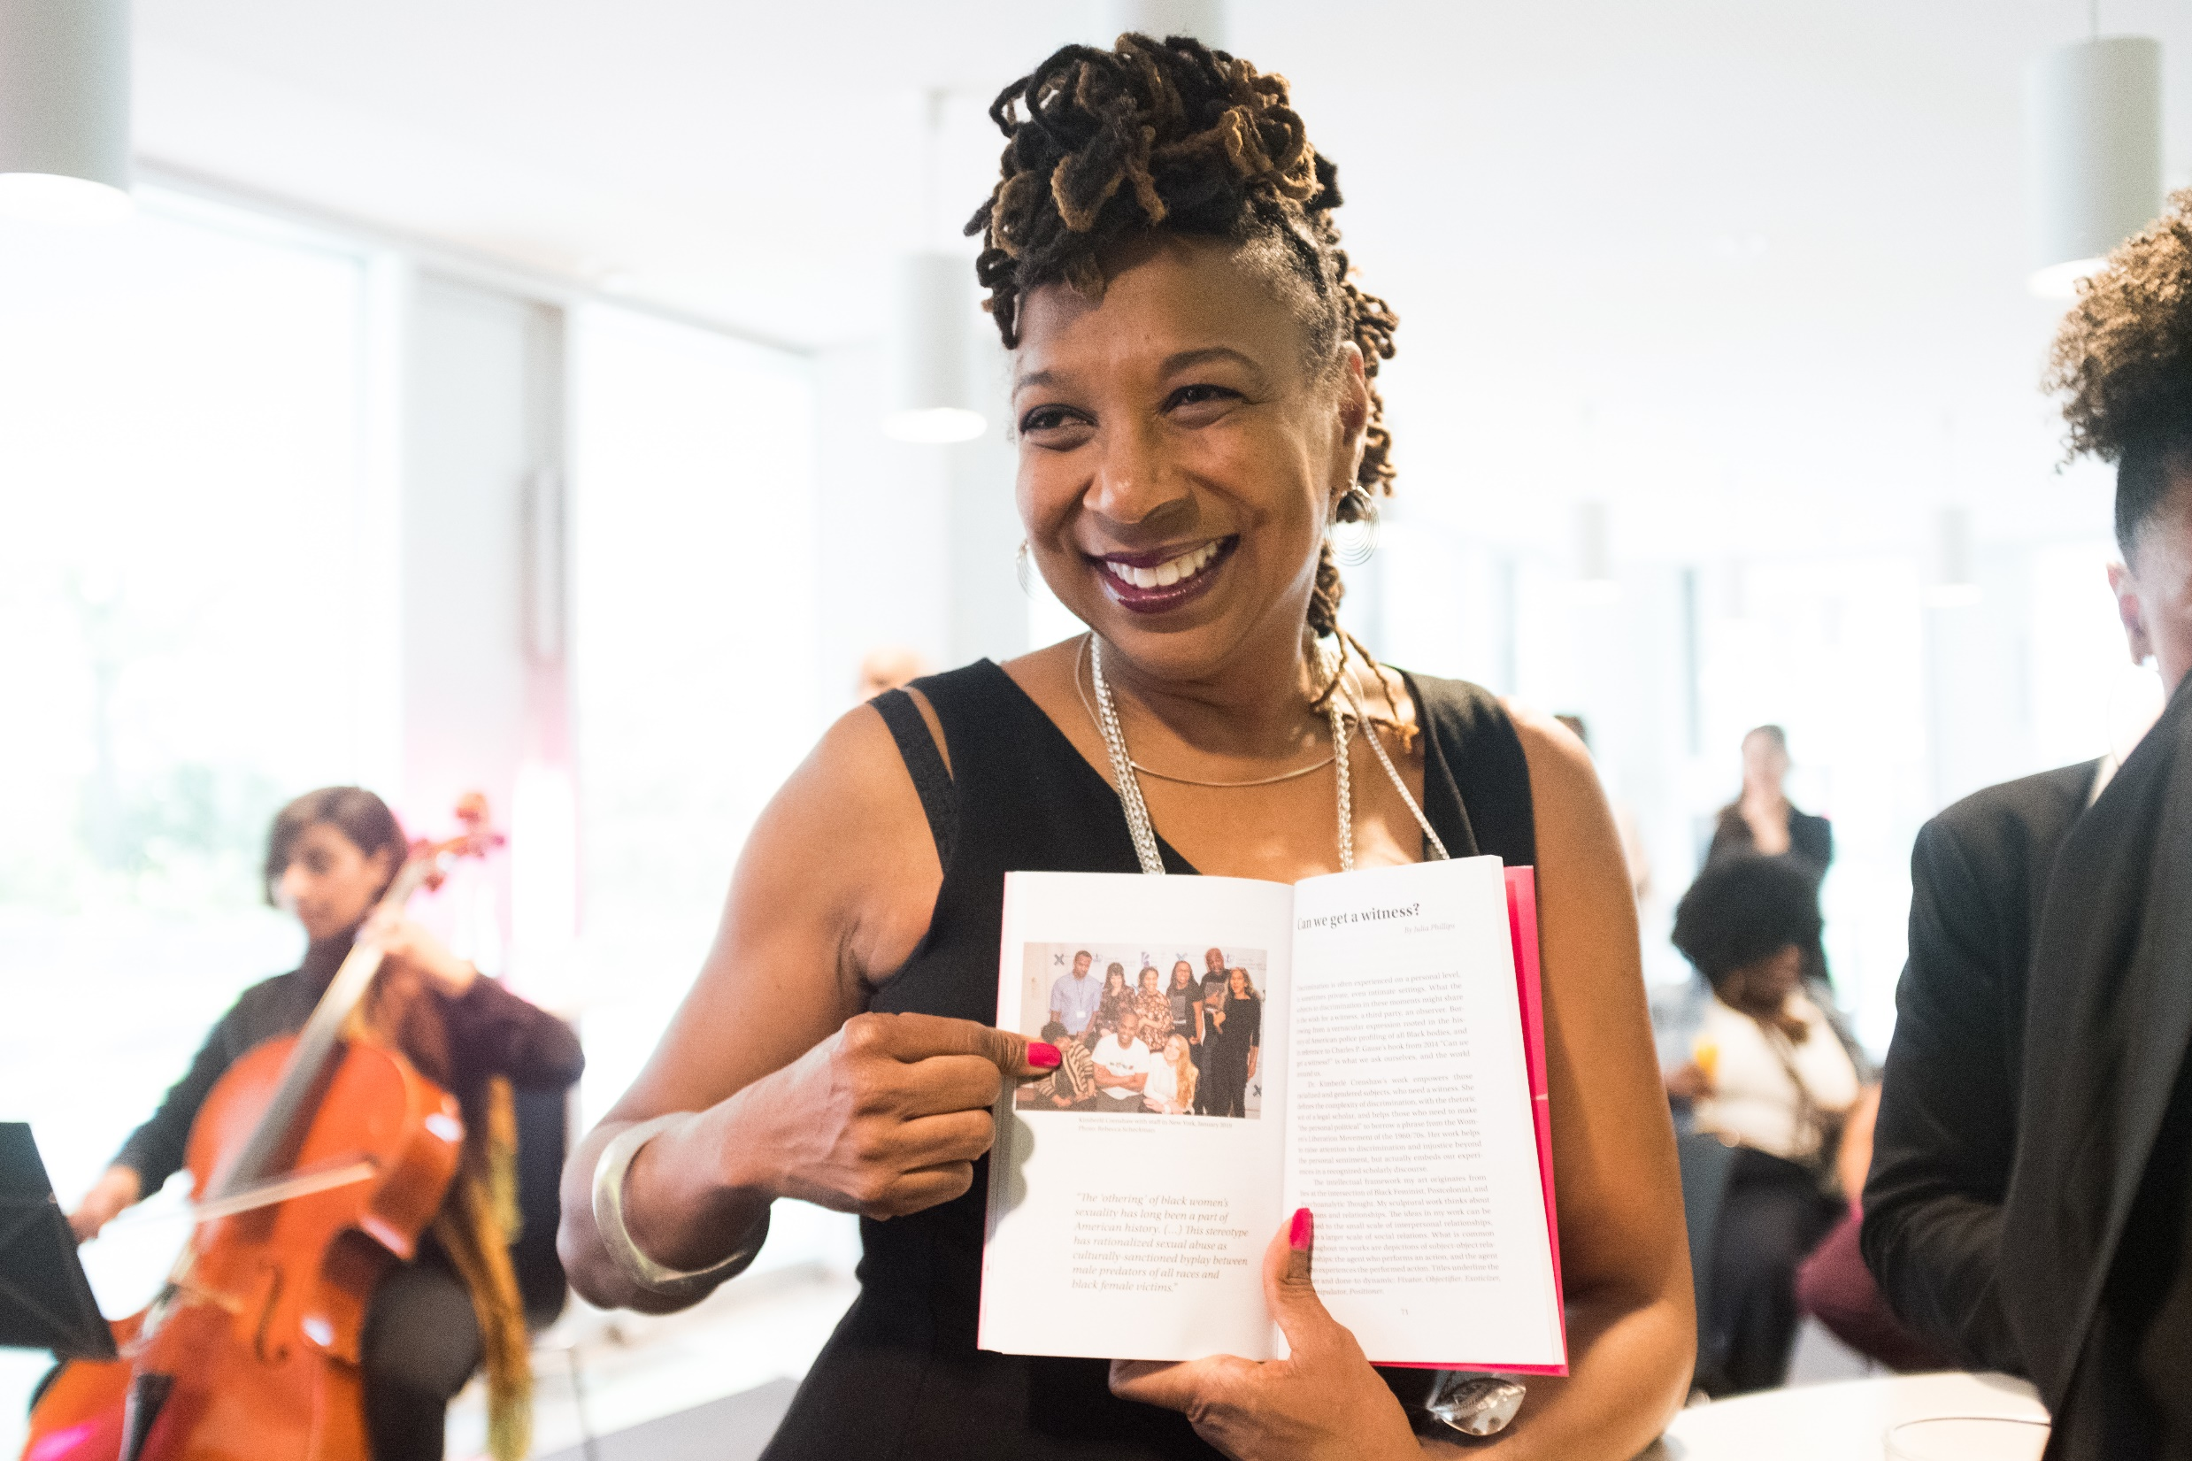
Intersectionality
“Discrimination, like traffic through an intersection, may flow in one direction and it may flow in another.
If an accident happens in an intersection, it can be caused by cars traveling from any number of directions and, sometimes, from all of them.”
– Kimberle Crenshaw
Kimberle Crenshaw Photo by Mohamed Badarne CC-BY-SA 2.0
Notes:
“Discrimination, like traffic through an intersection, may flow in one direction and it may flow in another.
If an accident happens in an intersection, it can be caused by cars traveling from any number of directions and, sometimes, from all of them.”
– Kimberle Crenshaw

Slide 54
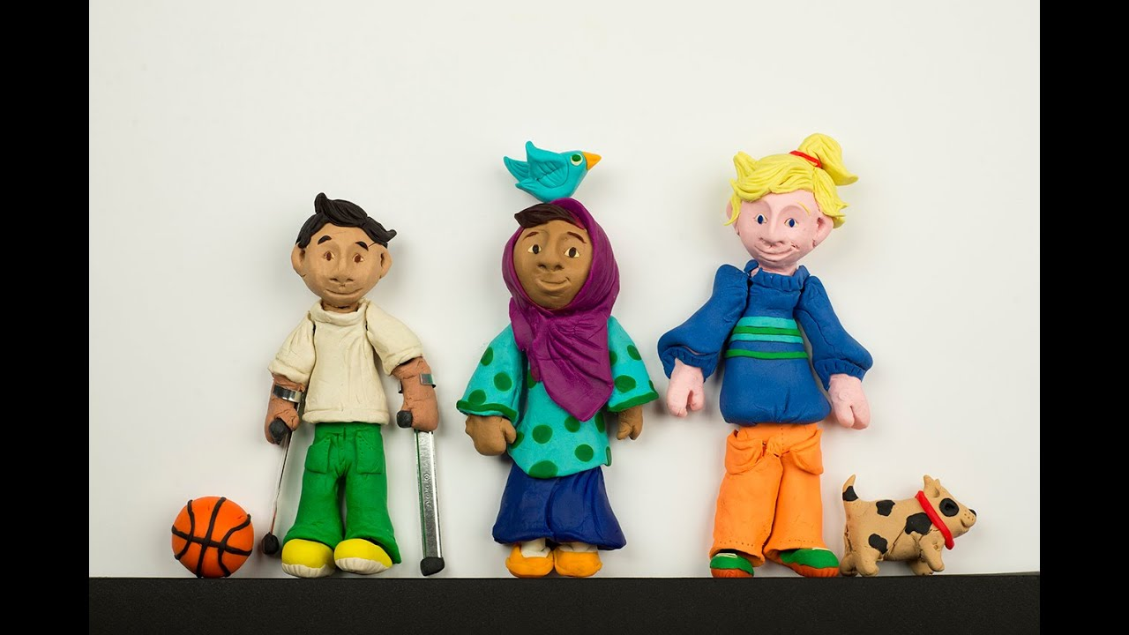
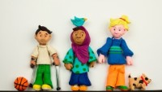
Intersectionality
Notes:
https://youtu.be/w6dnj2IyYjE

Slide 55

Intersectionality
Intersectionality describes the complex ways people can experience multiple forms of discrimination or prejudice based on different aspects of their identity.
For example, an overweight person from a visible minority group may be body shamed for their weight and also called racial ethnic slurs.
Furthermore, intersectionality recognizes that aspects of people’s identity may combine or add together to create unique forms of discrimination.
Photo by Roberto Hund from Pexels
Notes:
Intersectionality describes the complex ways people can experience multiple forms of discrimination or prejudice based on different aspects of their identity. For example, an overweight person from a visible minority group may be body shamed for their weight and also called racial ethnic slurs. Furthermore, intersectionality recognizes that aspects of people’s identity may combine or add together to create unique forms of discrimination

Slide 56

While we exert some control in the construction and presentation of our identities, the behavioral expectations that are attached to different statuses often lead to stereotyping, prejudice, and discrimination.
Photo by lookstudio - freepik.com
Notes:
While we exert some control in the construction and presentation of our identities, the behavioral expectations that are attached to different statuses often lead to stereotyping, prejudice, and discrimination.
<a href='https://www.freepik.com/photos/international-students'>International students photo created by lookstudio - www.freepik.com</a>

Slide 57
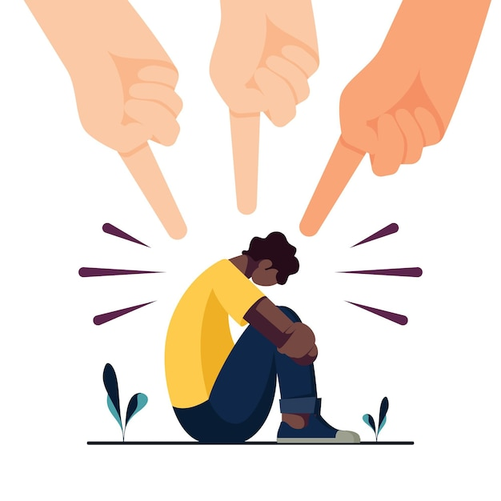
Stereotypes
Stereotypes: unwarranted generalizations about a particular group. They can be based on race, ethnicity, gender, religion, or other statuses.
Unjustified expectations that rely on received wisdom or casual observation rather than actual evidence.
Stereotypes often persist because they are subject to confirmation bias. Once a stereotype exists, people selectively notice situations that seem to confirm or reinforce their expectations, thus perpetuating the stereotype.
Prejudice vector by freepik.com
Notes:
ALL = Stereotypes
Stereotypes: unwarranted generalizations about a particular group. They can be based on race, ethnicity, gender, religion, or other statuses.
The notions, for example, that all Chinese people excel at math, all South Asians are good with technology, all women are emotional, or all Muslims are extremists represent unfounded simplifications about different groups.
Furthermore, they are unjustified because they rely on received wisdom or casual observation rather than actual evidence.
Stereotypes often persist because they are subject to confirmation bias. Once a stereotype exists, people selectively notice situations that seem to confirm or reinforce their expectations, thus perpetuating the stereotype.

Slide 58
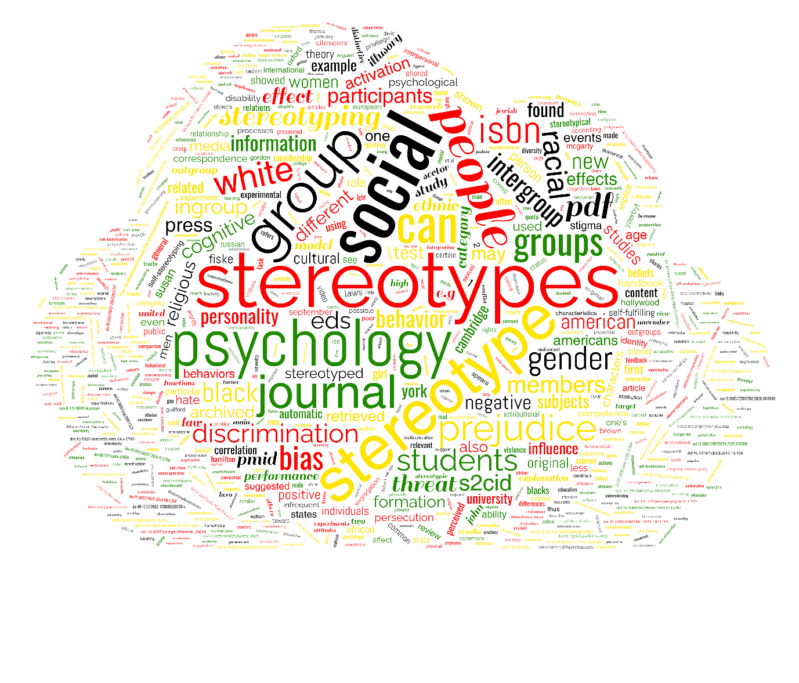
Stereotype threat
One of the dangers of stereotypes is that the people being stereotyped may start to believe these false characterizations are true.
Stereotype threat: poor performance in the face of negative stereotypes.
Stereotype: Asians are good at math.
Stereotype: Women can’t do math.
Two groups of Asian female college students were given a math test. Before the test, one group was given a survey that highlighted their Asian identity. The other group was given a survey that highlighted the fact that they were female.
The group who were made sensitive to their Asian heritage performed better on the test than the group made sensitive to their gender.
Artwork by Hi Profile is licensed under a CC BY-NC-SA 4.0 International License.
Notes:
One of the dangers of stereotypes is that the people being stereotyped may start to believe these false characterizations are true.
Stereotype threat: poor performance in the face of negative stereotypes.
Stereotype: Asians are good at math.
Stereotype: Women can’t do math.
Two groups of Asian female college students were given a math test. Before the test, one group was given a survey that highlighted their Asian identity. The other group was given a survey that highlighted the fact that they were female.
The group who were made sensitive to their Asian heritage performed better on the test than the group made sensitive to their gender.

Slide 59
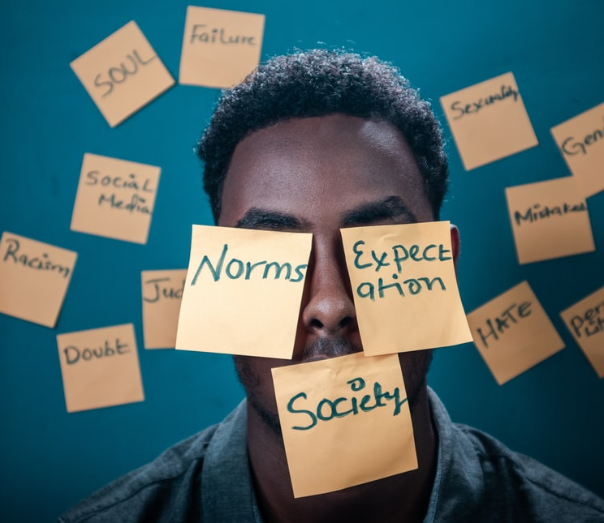
Prejudice and Discrimination
Some stereotypes can seem harmless, but we must be aware of their existence particularly when they are linked to prejudice and discrimination.
While stereotypes are unfounded because they cannot apply to all or even most members of a particular group, they are not always negative. Stereotypes can be positive, negative, or neutral.
Prejudice, on the other hand, refers to negative, often unconscious, and preconceived notions about others.
The word prejudice can be broken down into two parts: “pre” and “judgment.”
E.g., Muslim women are all oppressed.
Prejudice differs from stereotypes insofar as they contain a moral judgment about individuals or groups.
To the extent that we judge others negatively without even knowing them, we are displaying prejudiced attitudes.
Photo by Yasin Yusuf on Unsplash
Notes:
Some stereotypes can seem harmless, but we must be aware of their existence particularly when they are linked to prejudice and discrimination.
While stereotypes are unfounded because they cannot apply to all or even most members of a particular group, they are not always negative. Stereotypes can be positive, negative, or neutral.
Prejudice, on the other hand, refers to negative, often unconscious, and preconceived notions about others.
The word prejudice can be broken down into two parts: “pre” and “judgment.”
E.g., Muslim women are all oppressed.
Prejudice differs from stereotypes insofar as they contain a moral judgment about individuals or groups.
To the extent that we judge others negatively without even knowing them, we are displaying prejudiced attitudes.

Slide 60
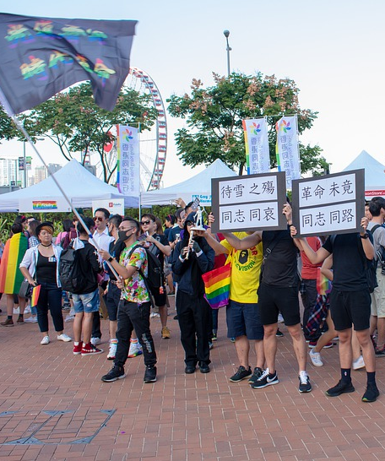
Discrimination
When people act on stereotypes and prejudiced notions, they are engaging in discrimination.
Discrimination is any act, whether deliberate or not, that has the intent or the effect of adversely affecting others on grounds other than merit or acquired skills.
E.g., Refusing to hire someone because of his or her sexuality.
Image by Kon Zografos from Pixabay
Notes:
When people act on stereotypes and prejudiced notions, they are engaging in discrimination.
Discrimination is any act, whether deliberate or not, that has the intent or the effect of adversely affecting others on grounds other than merit or acquired skills.
E.g., Refusing to hire someone because of his or her sexuality.

Slide 61
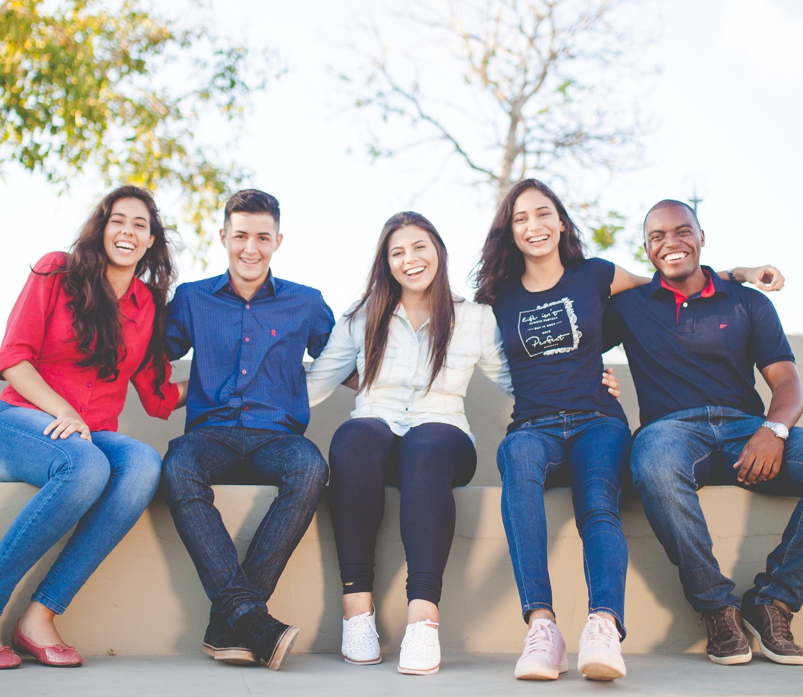
Social Construct of RACE
What is race?
The popular assumption is that race is associated with genetic or physical differences, particularly those based on skin color.
There are biological differences between individuals and some of these differences are grouped based on their geographical origin, but the biological differences between any two individuals are far greater than the differences between the presumed “races” of people.
Political and social factors, more than science and biology, provided us the categories of race that we are familiar with today.
Photo by Naassom Azevedo on Unsplash
Notes:
What is race?
The popular assumption is that race is associated with genetic or physical differences, particularly those based on skin color.
There are biological differences between individuals and some of these differences are grouped based on their geographical origin, but the biological differences between any two individuals are far greater than the differences between the presumed “races” of people.
Political and social factors, more than science and biology, provided us the categories of race that we are familiar with today.

Slide 62
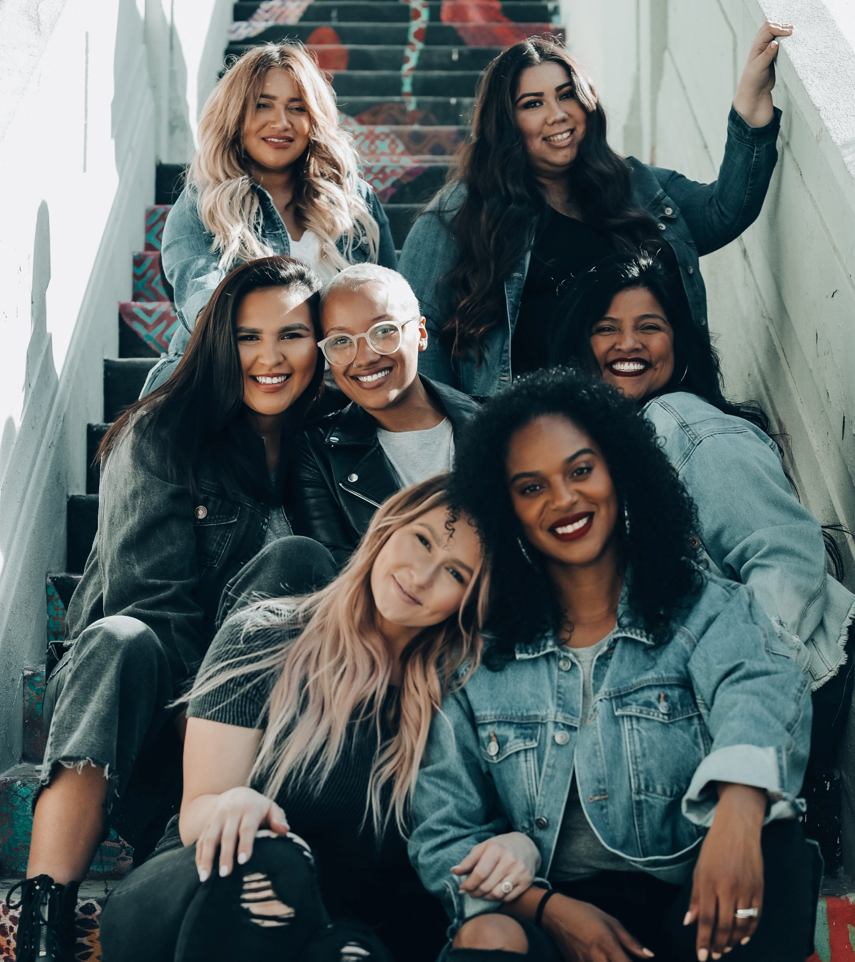
RACE
Historically, race was a concept used to dominate certain groups of people and to take away their land.
When we think of race, we often think of non-white people. But at various times through history, groups like the Irish, the Italians, the Jews were describes as “inferior races.”
Notions of difference combined with theories of superiority and inferiority justifies colonial expansion and exploitation.
The concept of race was used to control, marginalize, and oppress large segments of the population.
Photo by Joel Muniz on Unsplash
Notes:
Historically, race was a concept used to dominate certain groups of people and to take away their land.
When we think of race, we often think of non-white people. But at various times through history, groups like the Irish, the Italians, the Jews were describes as “inferior races.”
Notions of difference combined with theories of superiority and inferiority justifies colonial expansion and exploitation.
The concept of race was used to control, marginalize, and oppress large segments of the population.

Slide 63


Notes:
An example of how powerful stereotypes about race can be!
Watch this video to learn about the famous “doll study” where small children are asked simple questions about dark-skinned and light-skinned dolls (Source: Fanpage.it, 2016).
Their answers reveal how race can damage a child’s self-identity.
https://youtu.be/QRZPw-9sJtQ

Slide 64

Race and Resistance
But we must note that activists, artists, intellectuals, and everyday people have always challenged racism.
Racial identities that were originally imposed to legitimate oppression and to mark inferiority have been reclaimed as sources of pride and political struggle and community.
By rejecting the negative roles ascribed to race and finding inspiration in the histories of social and political struggle and resistance, many have embraced racial and ethnic categories as identities useful for social justice struggles.
Photo by PNW Production from Pexels.com
Notes:
But we must note that activists, artists, intellectuals, and everyday people have always challenged racism.
Racial identities that were originally imposed to legitimate oppression and to mark inferiority have been reclaimed as sources of pride and political struggle and community.
By rejecting the negative roles ascribed to race and finding inspiration in the histories of social and political struggle and resistance, many have embraced racial and ethnic categories as identities useful for social justice struggles.

Slide 65

BREAK
Photo by Angela Roma from Pexels.com
Notes:
15 Minute Break
This slide can be moved to where you have your class break(s)

Slide 66

Indigenous Identity
All First Nations across the country hunted and gathered plants for both food and medicinal purposes.
Indigenous peoples occupied North America for thousands of years before European explorers first arrived on the eastern shores of the continent in the 11th century.
In the 1500s, Europeans returned to the eastern shores of North America to establish settlements.
The great new land of opportunity and plenty resources attracted man Europeans from the Basque, Breton, Spanish, Portuguese, French, Irish and the English
As they returned each these fishermen developed an informal trade system with First Nations peoples
And so began the beginning of the end of the Indigenous traditional way of life as Europeans later became the dominant peoples of North America.
(Illustration: Shaun Vincent/Canadian Geographic
Tribe photo by - freepik.com
Notes:
All First Nations across the country hunted and gathered plants for both food and medicinal purposes.
Indigenous peoples occupied North America for thousands of years before European explorers first arrived on the eastern shores of the continent in the 11th century.
In the 1500s, Europeans returned to the eastern shores of North America to establish settlements.
The great new land of opportunity and plenty resources attracted man Europeans from the Basque, Breton, Spanish, Portuguese, French, Irish and the English
As they returned each these fishermen developed an informal trade system with First Nations peoples
And so began the beginning of the end of the Indigenous traditional way of life as Europeans later became the dominant peoples of North America.
Let’s start by bringing in the voice of an Indigenous person of Canada to see how they identify themselves:

Slide 67

Indigenous Identity
First, it is important to note that there is a difference between how external agencies identify Indigenous peoples and how they identify themselves.
The complexities of Indigenous identity are deeply rooted in colonialism.
For example, Indigenous Peoples in Canada are identified legally as “status Indian” even though they do not live in or come from India.
Initially, the criteria used to define who was Indigenous were quite expansive.
However, the federal government realized, over time, that narrowing the definition would reduce the number of people who met the criteria.
This helped their goal of assimilation.
Image by Margaret Van de Pitte from Pixabay
Notes:
First, it is important to note that there is a difference between how external agencies identify Indigenous peoples and how they identify themselves.
The complexities of Indigenous identity are deeply rooted in colonialism.
For example, Indigenous Peoples in Canada are identified legally as “status Indian” even though they do not live in or come from India.
Initially, the criteria used to define who was Indigenous were quite expansive.
However, the federal government realized, over time, that narrowing the definition would reduce the number of people who met the criteria.
This helped their goal of assimilation.

Slide 68

Indigenous , Aboriginal, METIS, INUIT?
There is no generally accepted definition of Indigenous Peoples in a global context. Some countries refer to Indigenous Peoples as the people who were there first at contact. Others refer to Indigenous Peoples as the nomadic peoples within their borders.
Indian, Native, First Nations, Aboriginal, Aboriginal Peoples, Indigenous? Métis? Which one is it?
The Canadian Constitution recognizes three groups of Aboriginal peoples: Indians (more commonly referred to as First Nations), Inuit and Métis. These are three distinct peoples with unique histories, languages, cultural practices and spiritual beliefs
Photo by form PxHere
Notes:
There is no generally accepted definition of Indigenous Peoples in a global context.
Some countries refer to Indigenous Peoples as the people who were there first at contact.
Others refer to Indigenous Peoples as the nomadic peoples within their borders.
Indian, Native, First Nations, Aboriginal, Aboriginal Peoples, Indigenous? Métis? Which one is it?
The Canadian Constitution recognizes three groups of Aboriginal peoples:
Indians (more commonly referred to as First Nations),
Inuit
Métis.
These are three distinct peoples with unique histories, languages, cultural practices and spiritual beliefs.

Slide 69


Aboriginal peoples
Notes:
Let’s start by bringing in the voice of an Indigenous person of Canada to see how they identify themselves:
How do we categorize Indian people?
https://www.ictinc.ca/blog/indigenous-peoples-terminology-guidelines-for-usage
https://youtu.be/Bfm_7kXktZU

Slide 70

Notes:
What does being Indigenous mean?
We asked, and you shared with us your experiences of being Indigenous.
To mark National Indigenous Peoples Day, we're sharing the profiles of 18 Indigenous leaders and change-makers.
You can access them here http://bit.ly/2sUQvc8

Slide 71

WHO ARE THE METIS?
Notes:
https://youtu.be/YvulIRnPE3Y
Who are Métis?
Some 450,000 Aboriginal people identify themselves as Métis.
Their history, language and culture dates back hundreds of years, but most Canadians know little about them.
The Métis peoples constitute a distinct Aboriginal nation.
They have a shared history, common culture, a distinct way of life, traditional territory and collective consciousness.
Métis are Aboriginal peoples distinct from the First Nations and Inuit.
Métis are people of mixed First Nation and European ancestry who identify themselves as Métis.
The term Métis is broadly used in Canada to designate people who have mixed First Nations and European, Asian, or African ancestry.
The Métis have a unique culture that draws on their diverse ancestral origins.
On September 27, 2002, the Métis National Council adopted the following national definition of Métis:
“A person who self-identifies as Métis, is of historic Métis Nation Ancestry, is distinct from other Indigenous Peoples and is accepted by the Métis Nation.
The Métis Nation governments in each province manage Métis registration.”

Slide 72

WHO ARE THE METIS?
Who are THE INUIT?
Notes:
https://youtu.be/RYMEoFOZavs
Who are THE INUIT?

Slide 73

BROKEN PROMISES!
Notes:
A History of Broken Promises!
Canadians have been breaking their promises to Indigenous people from since the beginning!
This video is part of a longer version of nîpawistamâsowin: We Will Stand Up, a documentary from CBC Docs.
Here, Hubbard tells the story of Colten Boushie, a young Cree man who died from a gunshot wound to the back of the head after entering Gerald Stanley’s property with friends.
The trial and acquittal of Stanley raised questions about racism in Canada’s legal system.
https://youtu.be/IUHnKUaDYjs

Slide 74

Indigenous People
Notes:
Indigenous People
A Celebration of Indigenous Cultures Around the World (Source: In The Know, 2016)
https://youtu.be/kXWpDXZADCs

Slide 75

UNCONTACTED PEOPLE
There are more than a hundred uncontacted tribes around the world.
They are a vitally important part of humankind’s diversity, but they face catastrophe unless their land is protected.
Their way of life and identity are being threatened.
https://www.survivalinternational.org/uncontactedtribes
https://www.survivalinternational.org/tribes/uncontacted-brazil
Notes:
There are more than a hundred uncontacted tribes around the world.
They are a vitally important part of humankind’s diversity, but they face catastrophe unless their land is protected.
Their way of life and identity are being threatened.
https://www.survivalinternational.org/uncontactedtribes
https://www.survivalinternational.org/tribes/uncontacted-brazil

Slide 76

Social Identity Wheel
Adapted from the “Voices of Discovery” Intergroup Relations Centre, Arizona State University
Notes:
Activity: The identity wheel
Download and print the social-identity-wheel-handout.pdf
Fill out the outer rim of this identity wheel and write down your answers to the four questions in the centre of the wheel in your notes.
Self-reflection: Some identities are subject to prejudice and discrimination.
The status, social dominance, or level of acceptance of different identities depend on the society they exist in.

Slide 77

BREAKOUT GROUPS
Photo by Naassom Azevedo on Unsplash
Notes:
Consider these questions, and write your answers in your notes:
Have you ever been discriminated against, or treated differently or less equally than someone else?
Why do you think you were treated differently?
What parts of your identity do you think were being judged when you were treated differently?

Slide 78

Conclusion
Our identities are shaped by social, political, and cultural factors.
But we also have a certain amount of control over our identities.
The pictures we post on Facebook, for example, reflect the kind of image we want to present to the world.
One way we might define ourselves is as global citizens.
We might think of ourselves as citizens of the world whose assumptions, attitudes, and actions affect the lives of people all over the world.
Photo by Ann H – Pexels.com
Photo by Ann – Pexels.com
Notes:
Our identities are shaped by social, political, and cultural factors.
But we also have a certain amount of control over our identities.
The pictures we post on Facebook, for example, reflect the kind of image we want to present to the world.
One way we might define ourselves is as global citizens.
We might think of ourselves as citizens of the world whose assumptions, attitudes, and actions affect the lives of people all over the world.

Slide 79


QUESTIONS
Question Marks created by Starline - freepik.com
Notes:
Questions …

